Slide 1
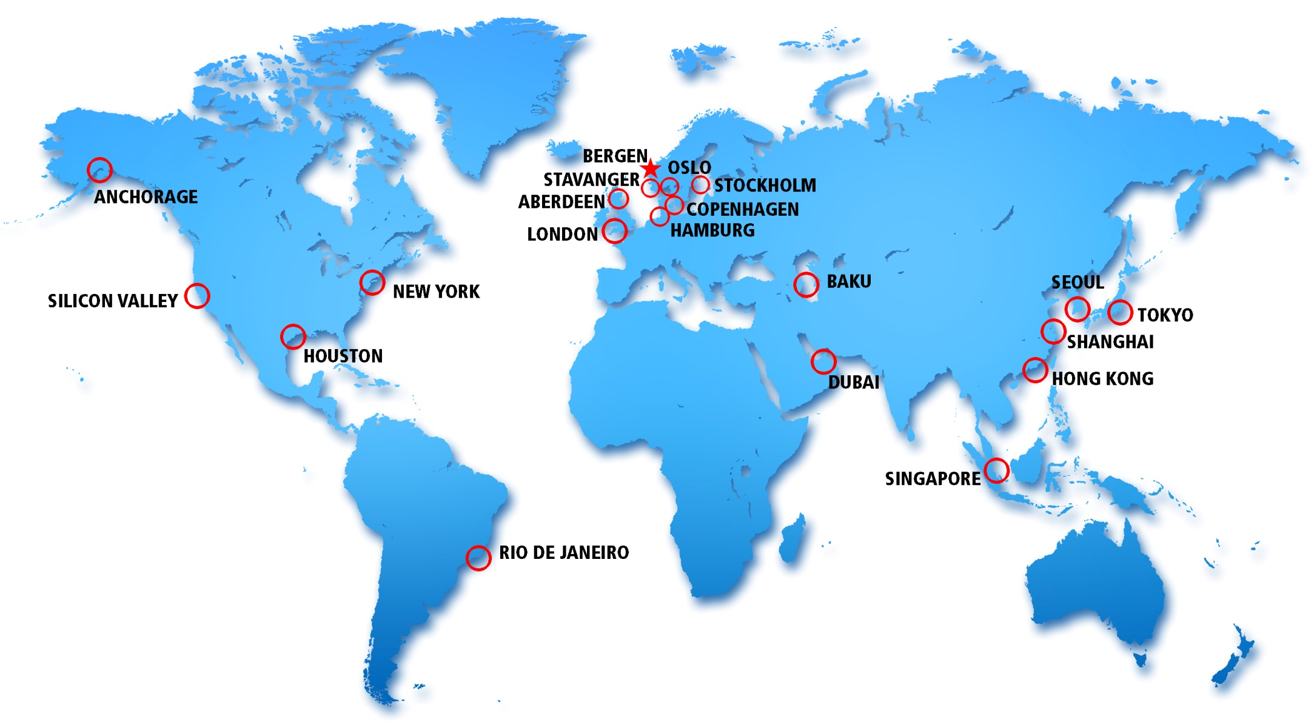
Presentation for
University of Houston AMS Chapter
Jan. 29, 2015

Slide 2
Private Sector Meteorology Presentation by Matt Haworth StormWatch Meteorologist, ImpactWeather Inc UH AMS Chapter Meeting January 29th, 2015

Slide 3
What is the Purpose of Private Sector?
Provide guidance to businesses to allow them to operate safely in a weather-sensitive environment
Provide guidance so businesses can activate their emergency response plans in a timely manner
Provide forecasts for both onshore and offshore locations for all different types of weather and wave conditions

Slide 4
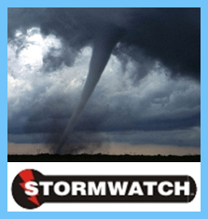
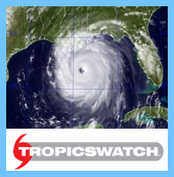
“Helping Businesses Operate Safely, Effectively and Efficiently in all Weather Conditions”

Slide 5
Divisions of ImpactWeather
Operations
Makes the forecasts
Job titles include Meteorologist, Staff Meteorologist, Senior Meteorologist and Tropical Meteorologist. Can also move into management
Sales and Marketing
Sells the forecasts to the clients. Many meteorologists work in sales
Client Services
Liaisons with the clients. Made up of meteorologists
IT
Also has many meteorologists to develop software

Slide 6
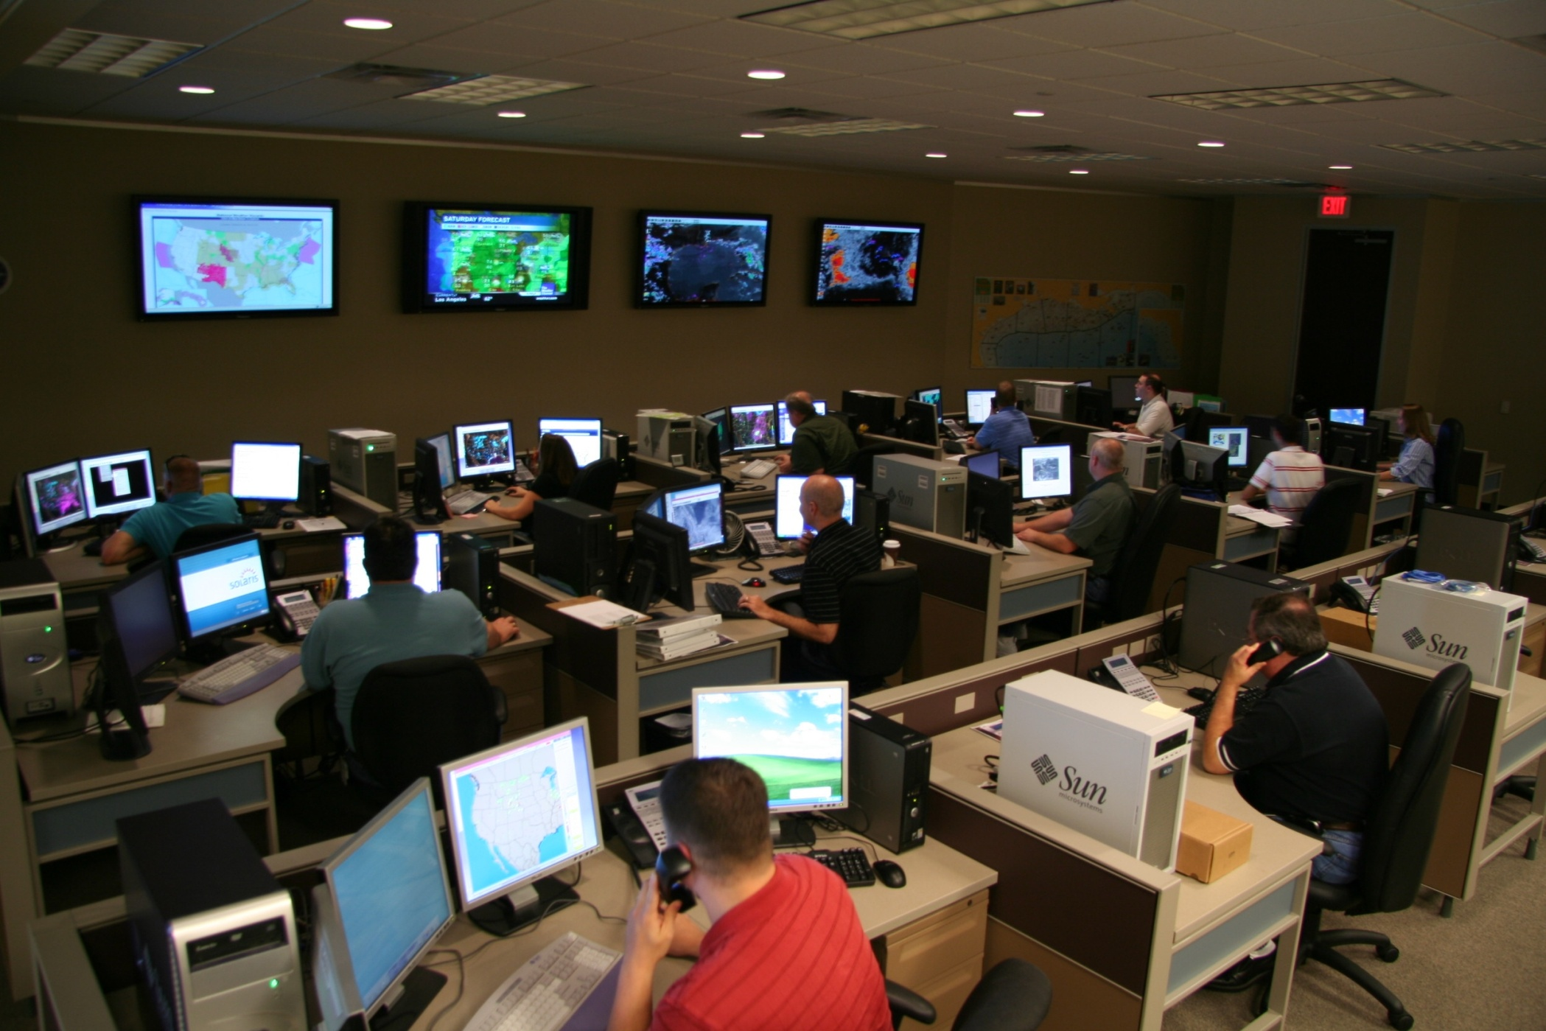
Our Operations Center

Slide 7
We monitor client locations worldwide and advise them of predicted impacts

Slide 8
StormWatch Overview
Makes day to day forecasts for land-based clients
Identifies major weather systems days in advance
Issues alerts for severe weather events (e.g. tornadoes, severe storms)
Radiosonde Program (IW, UH, NWS-HGX)
Opportunities to forecast on site

Slide 9
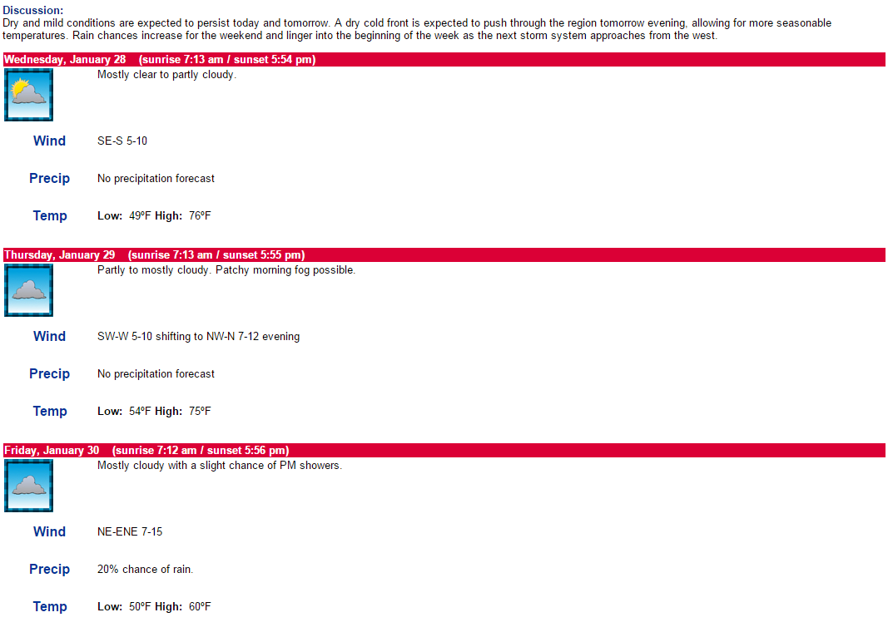
7-day planning forecasts help clients prepare for the week ahead

Slide 10
StormWatch Overview
Makes day to day forecasts for land based clients
Identifies major weather systems days in advance
Issues alerts for severe weather events (e.g. tornadoes, severe storms)
Radiosonde Program (IW, UH, NWS-HGX)
Opportunities to forecast on site

Slide 11
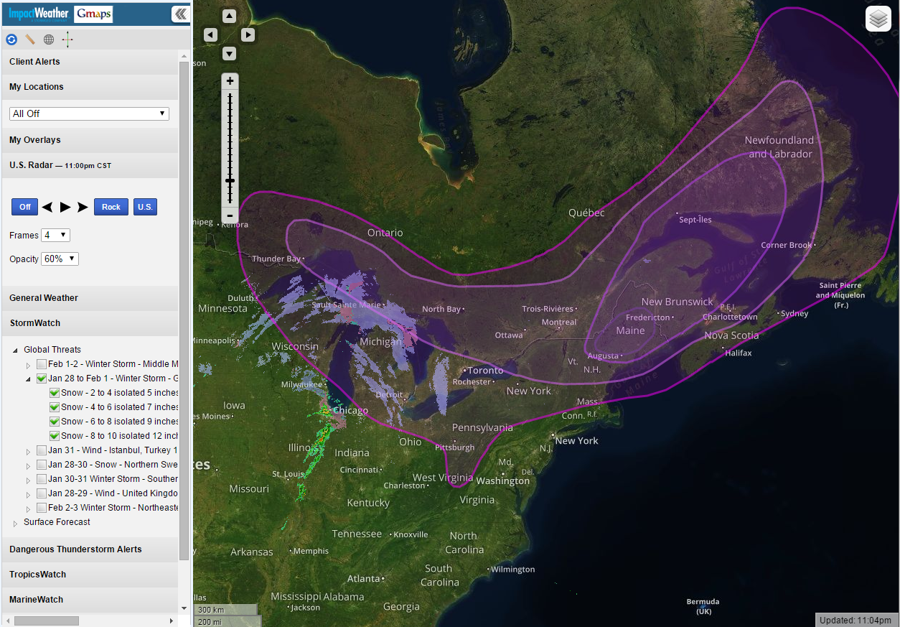
Winter Storm Threat

Slide 12
StormWatch Overview
Makes day to day forecasts for land based clients
Identifies major weather systems days in advance
Issues alerts for severe weather events (e.g. tornadoes, severe storms)
Radiosonde Program (IW, UH, NWS-HGX)
Opportunities to forecast on-site

Slide 13
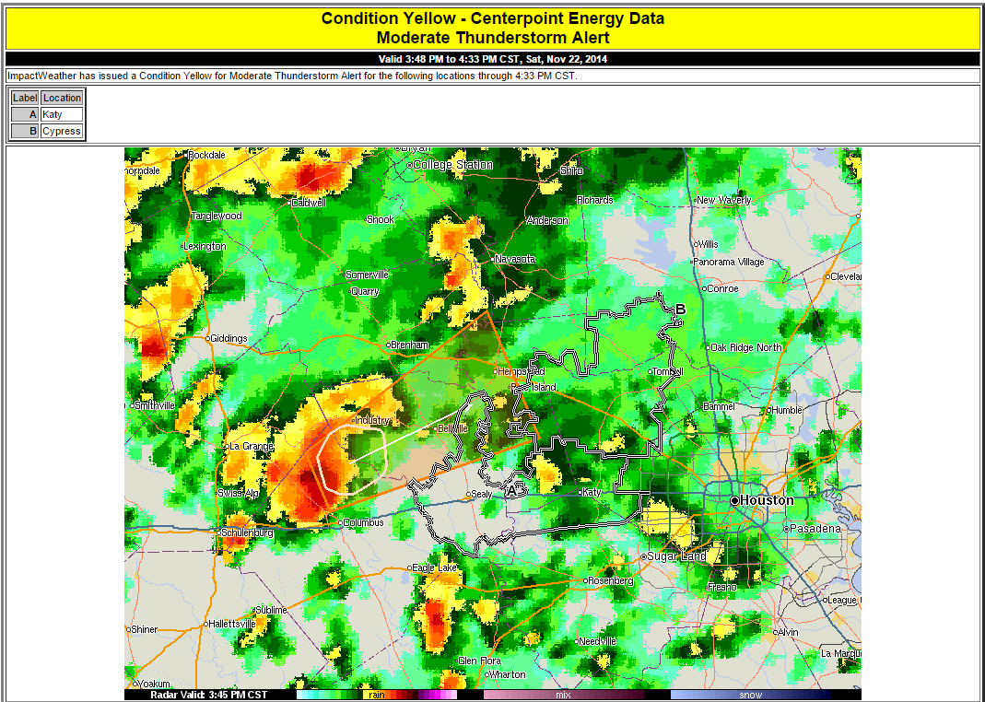
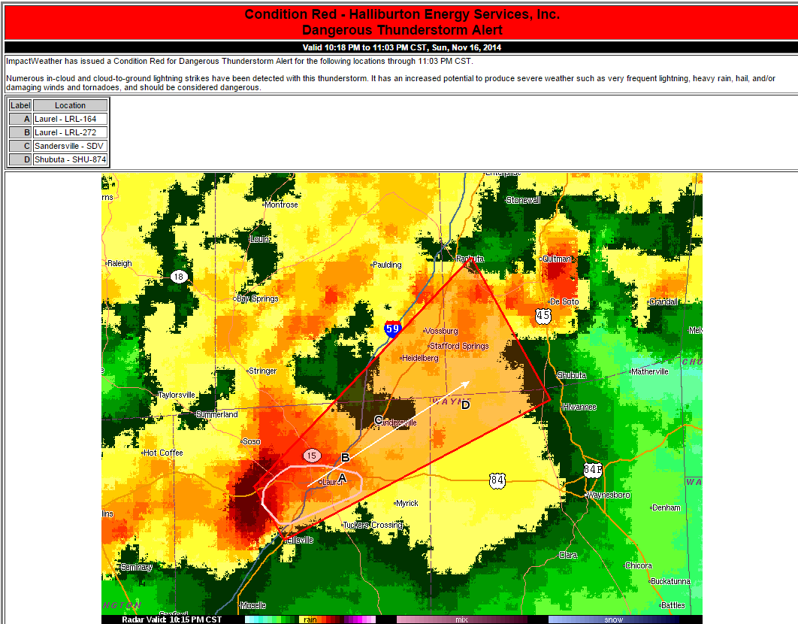
DTA’s

Slide 14
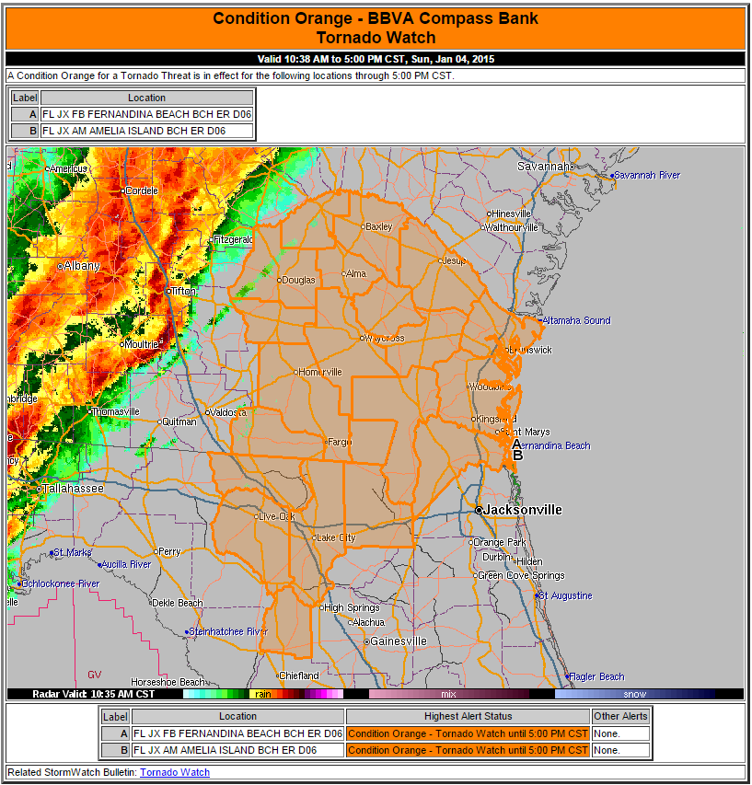
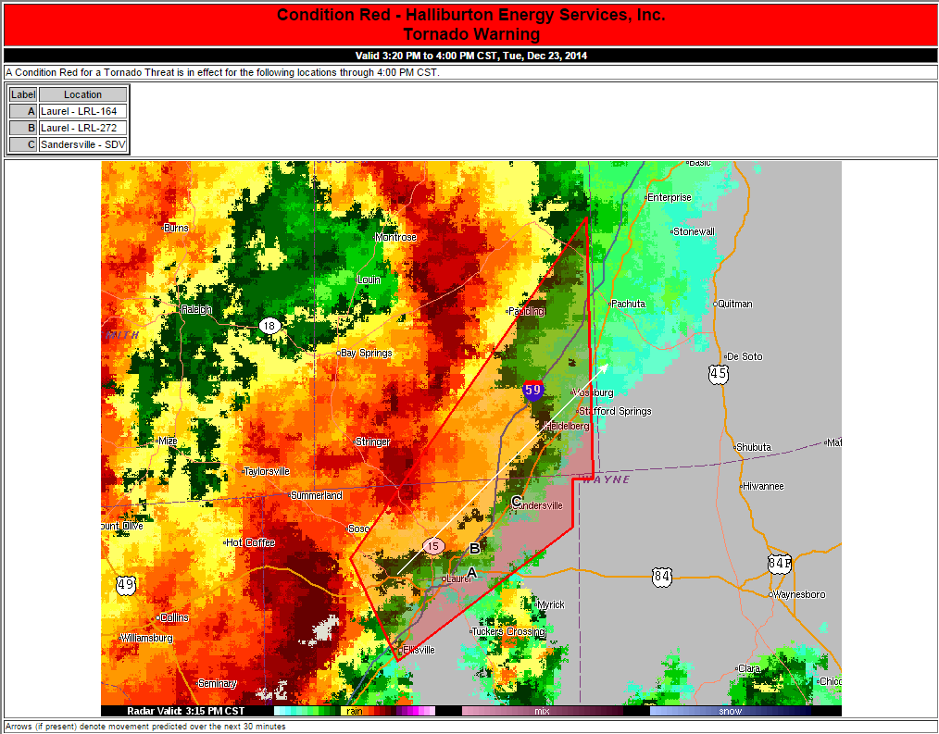
NWS Watch/Warning

Slide 15
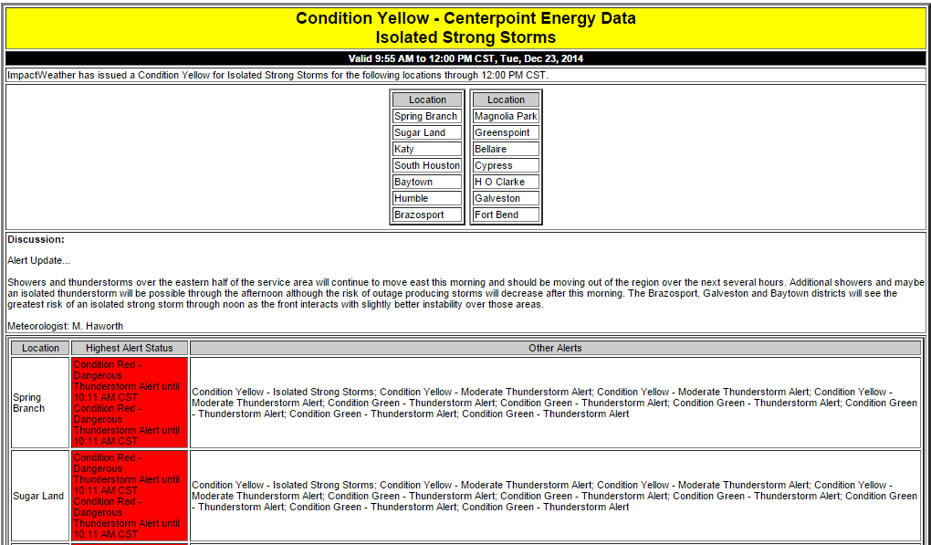
Supplemental Alerts

Slide 16
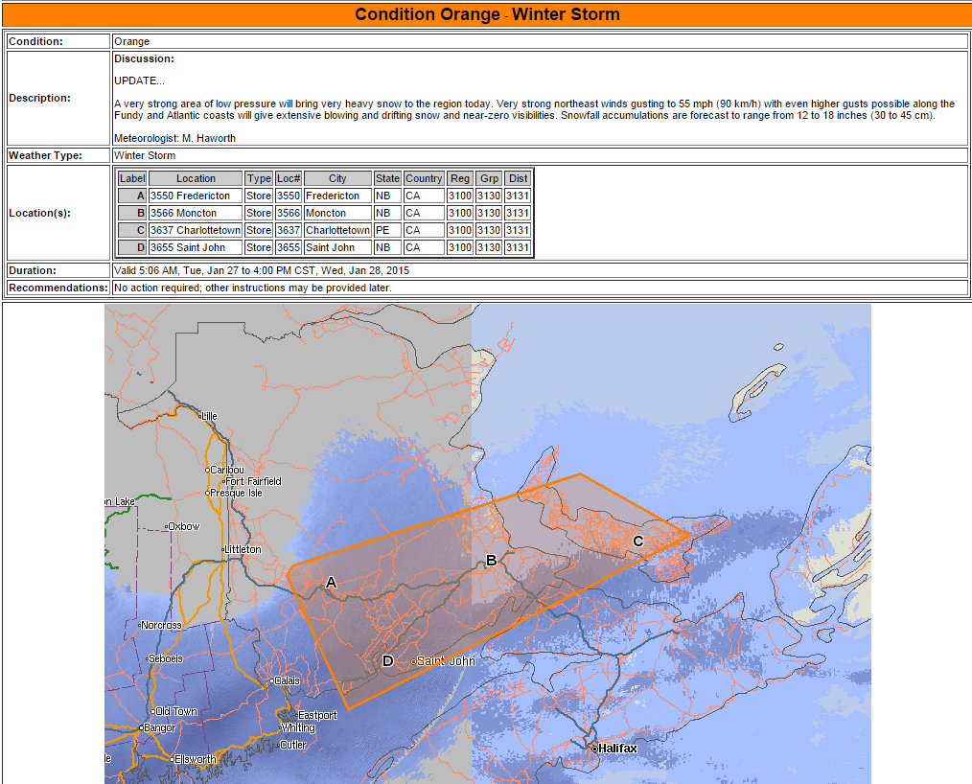

Slide 17
StormWatch Overview
Makes day to day forecasts for land based clients
Identifies major weather systems days in advance
Issues alerts for severe weather events (e.g. tornadoes, severe storms)
Radiosonde Program (IW, UH, NWS-HGX)
Opportunities to forecast on-site

Slide 18
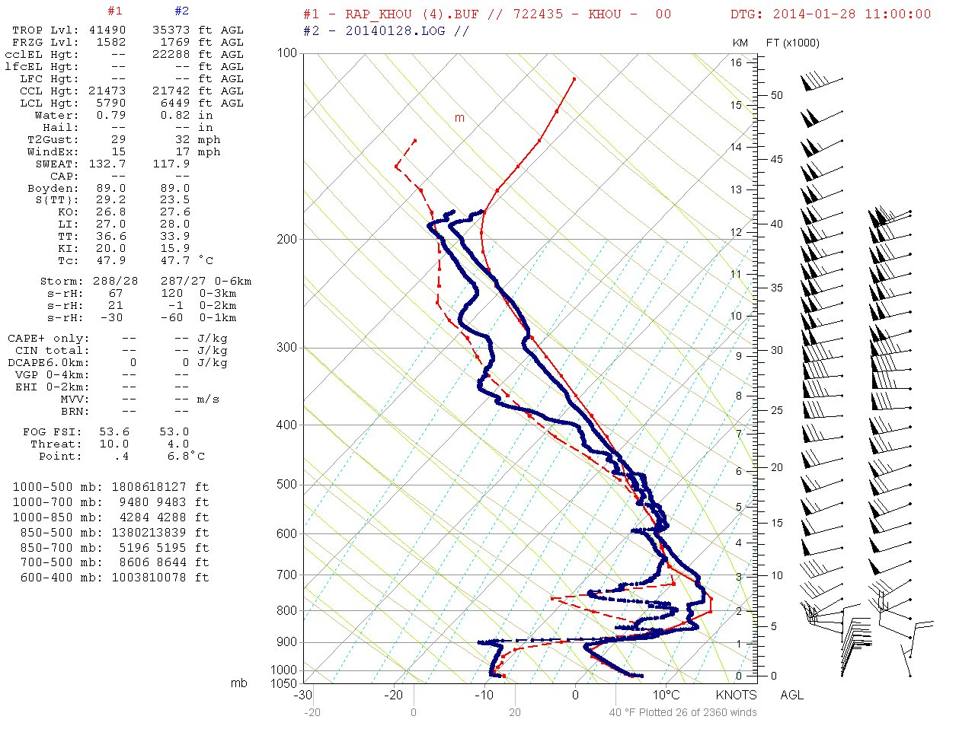
Model Comparison

Slide 19
StormWatch Overview
Makes day to day forecasts for land based clients
Identifies major weather systems days in advance
Issues alerts for severe weather events (e.g. tornadoes, severe storms)
Radiosonde Program (IW, UH, NWS-HGX)
Opportunities to forecast on site

Slide 20
Tropical cyclones represent the greatest threat to our clients worldwide

Slide 21
TropicsWatch Overview
Provide daily briefings on tropical activity for all basins worldwide
Issue advisories on active TCs and disturbances likely to develop worldwide
Issue special products to allow companies to properly activate their hurricane response plans
Make videos providing the latest information for clients
Fog forecasting

Slide 22
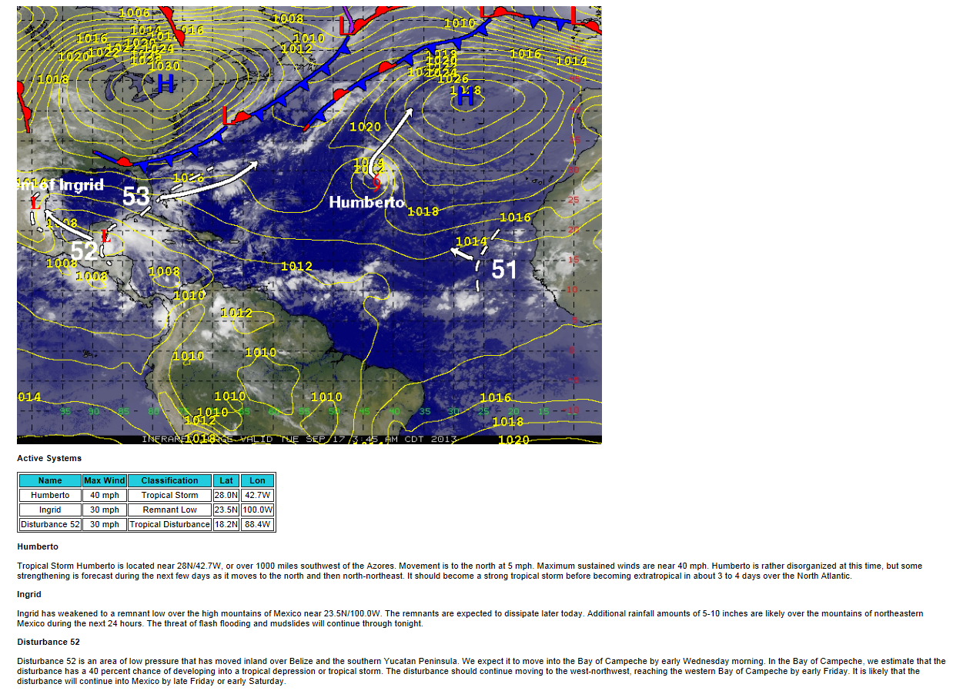
The North Atlantic Daily Briefing covers potential development for the next week
Outlook for the next week – or longer
Threats to business are identified/quantified

Slide 23
TropicsWatch Overview
Provide daily briefings on tropical activity for all basins worldwide
Issue advisories on active TCs and disturbances likely to develop worldwide
Issue special products to allow companies to properly activate their hurricane response plans
Make videos providing the latest information for clients
Fog forecasting

Slide 24
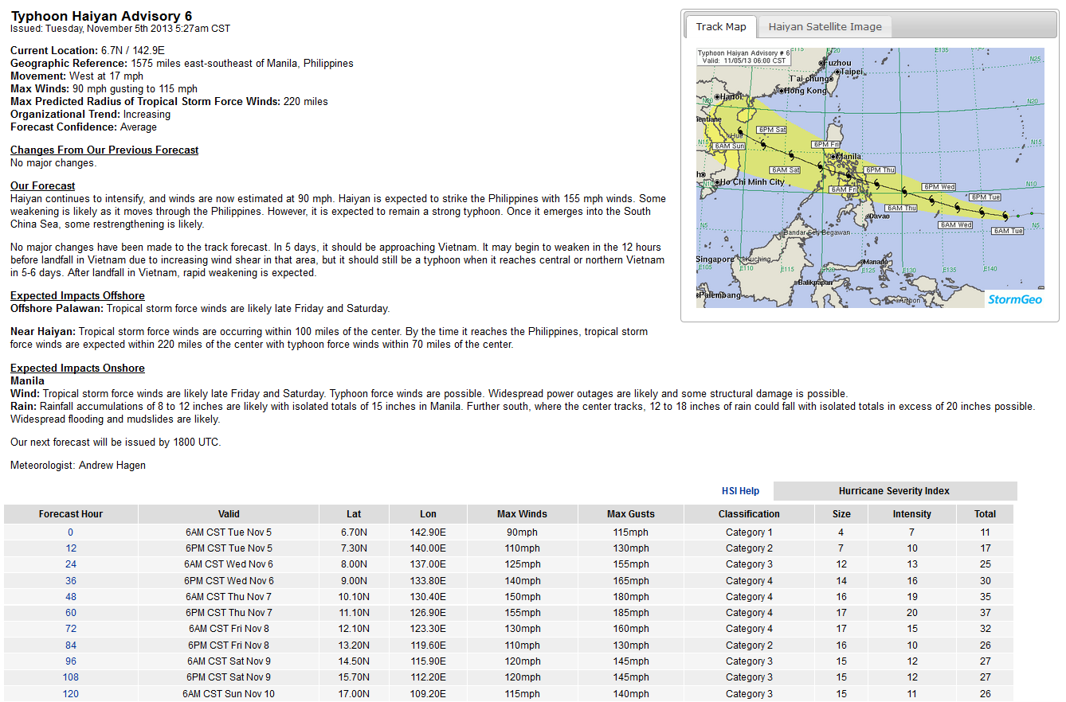
Advisory Example

Slide 25
TropicsWatch Overview
Provide daily briefings on tropical activity for all basins worldwide
Issue advisories on active TCs and disturbances likely to develop worldwide
Issue site forecasts and special products to allow companies to properly activate their hurricane response plans
Make videos providing the latest information for clients
Fog forecasting

Slide 26
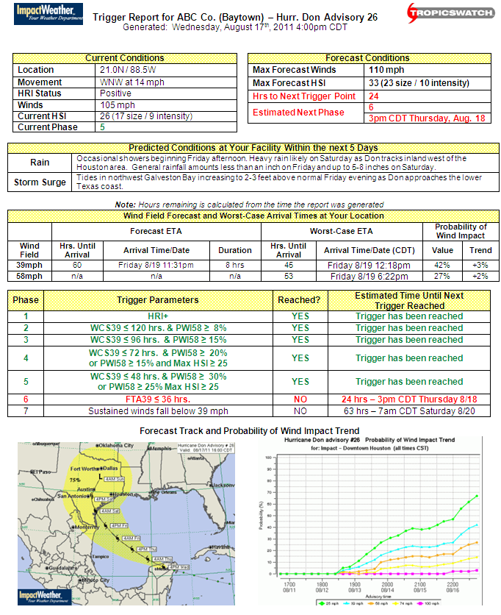
Objective guidance is incorporated into clients’ hurricane response plans
Current Conditions and Your Current HRP Phase
Impact Details and Timeline
Current and Projected HRP Phase Timeline

Slide 27
TropicsWatch Overview
Provide daily briefings on tropical activity for all basins worldwide
Issue advisories on active TCs and disturbances likely to develop worldwide
Issue site forecasts and special products to allow companies to properly activate their hurricane response plans
Make videos providing the latest information for clients
Fog forecasting

Slide 28
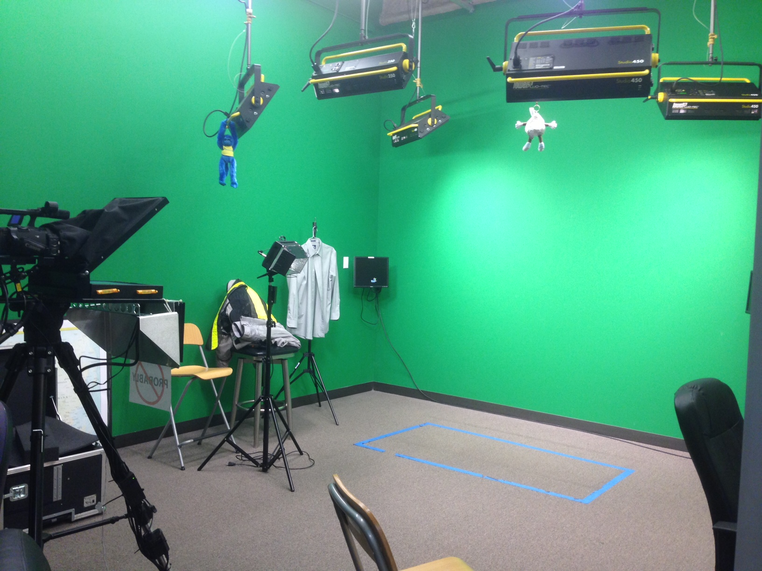
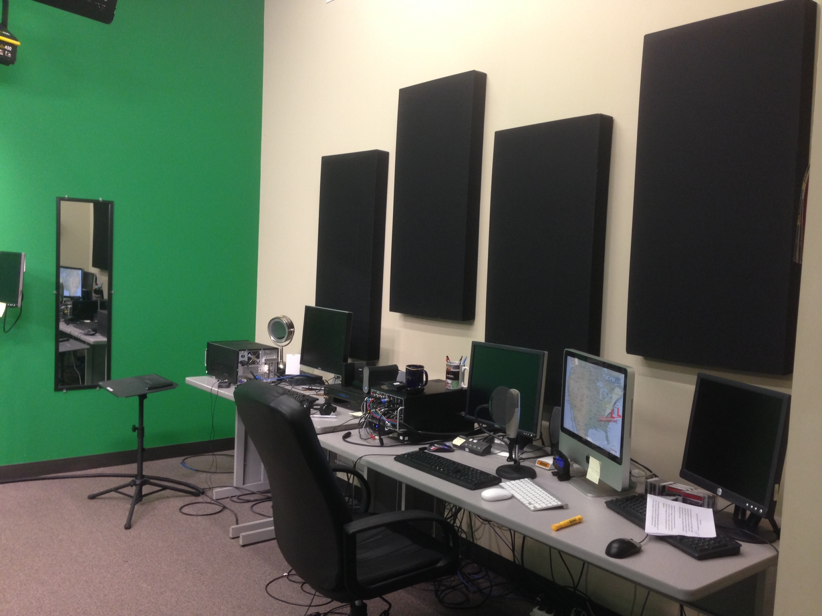
Full video capabilities in our green room

Slide 29
TropicsWatch Overview
Provide daily briefings on tropical activity for all basins worldwide
Issue advisories on active TCs and disturbances likely to develop worldwide
Issue site forecasts and special products to allow companies to properly activate their hurricane response plans
Make videos providing the latest information for clients
Fog forecasting

Slide 30
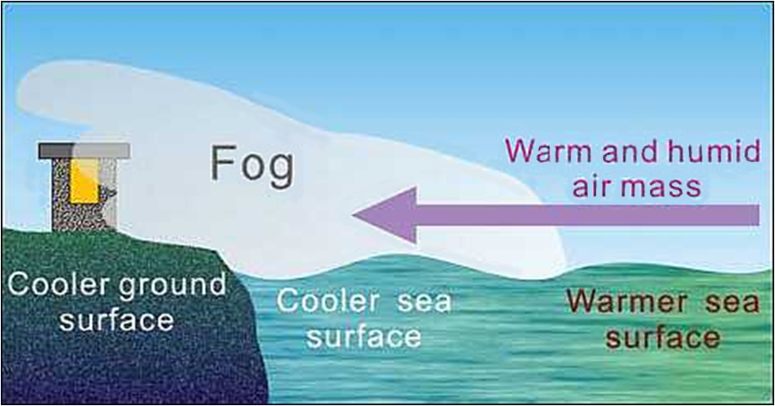
Fog forms when warm, humid air from well offshore flows over cooler water near shore

Slide 31
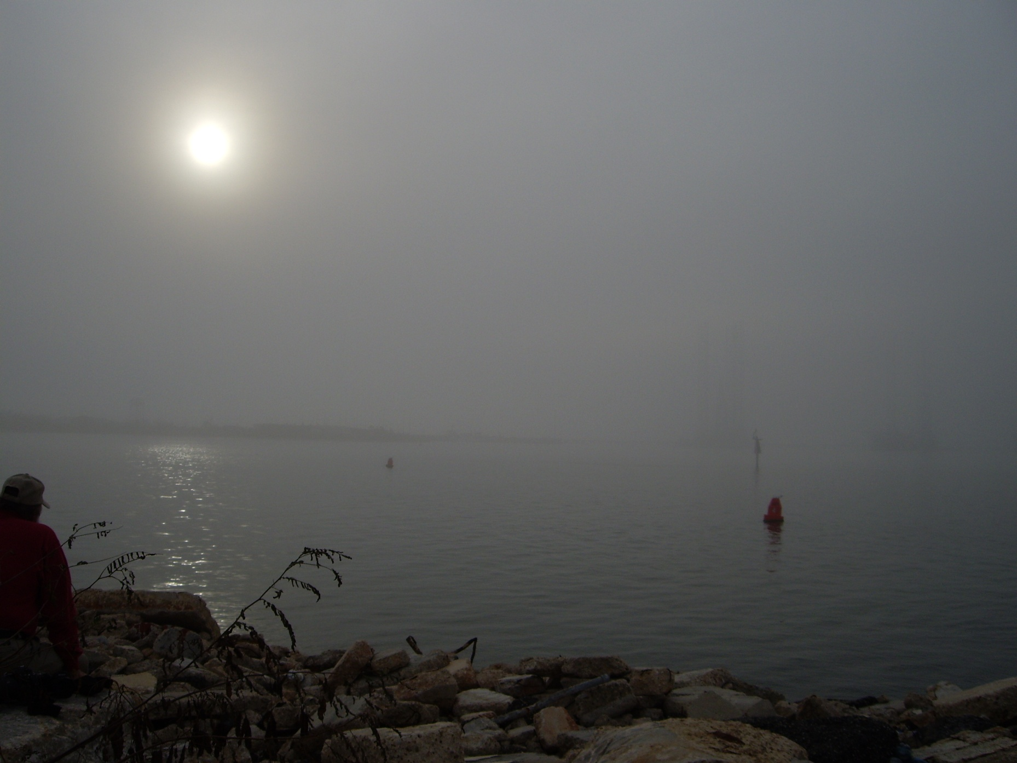
Mississippi Coast (Dec. 2006) late afternoon – marine fog is not just a morning phenomenon

Slide 32
Wind/sea forecasts help offshore clients operate efficiently through year-round

Slide 33
MarineWatch Overview
Wind and wave forecasting
Route Forecasting
Severe Weather Alerting
Opportunities to work offshore on drill ships

Slide 34
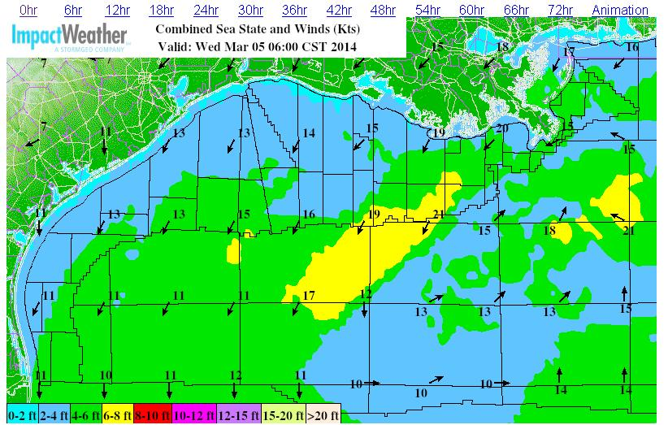
Gulf of Mexico Wind and Wave Forecast

Slide 35
MarineWatch Overview
Wind and wave forecasting
Route Forecasting
Severe Weather Alerting
Opportunities to work offshore on drill ships

Slide 36
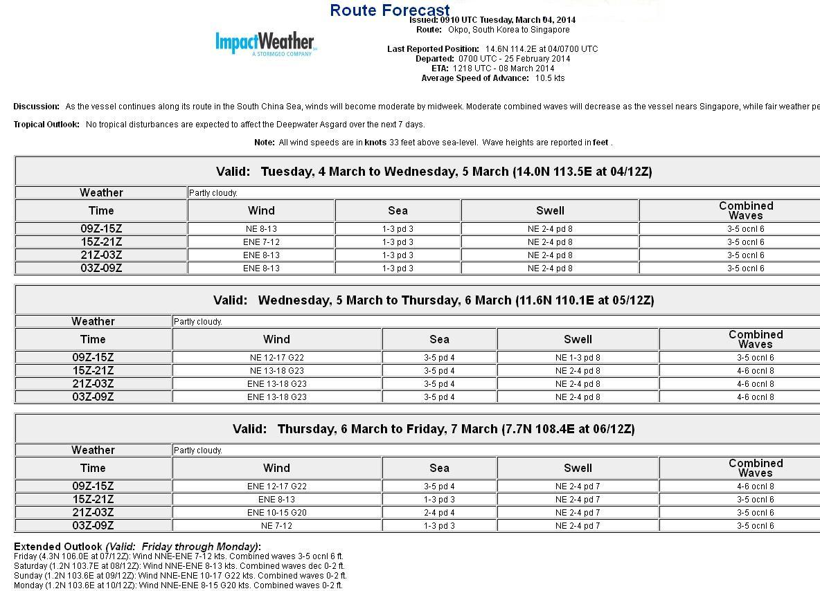
Route Forecast Example

Slide 37
MarineWatch Overview
Wind and wave forecasting
Route Forecasting
Severe Weather Alerting
Opportunities to work offshore on drill ships

Slide 38
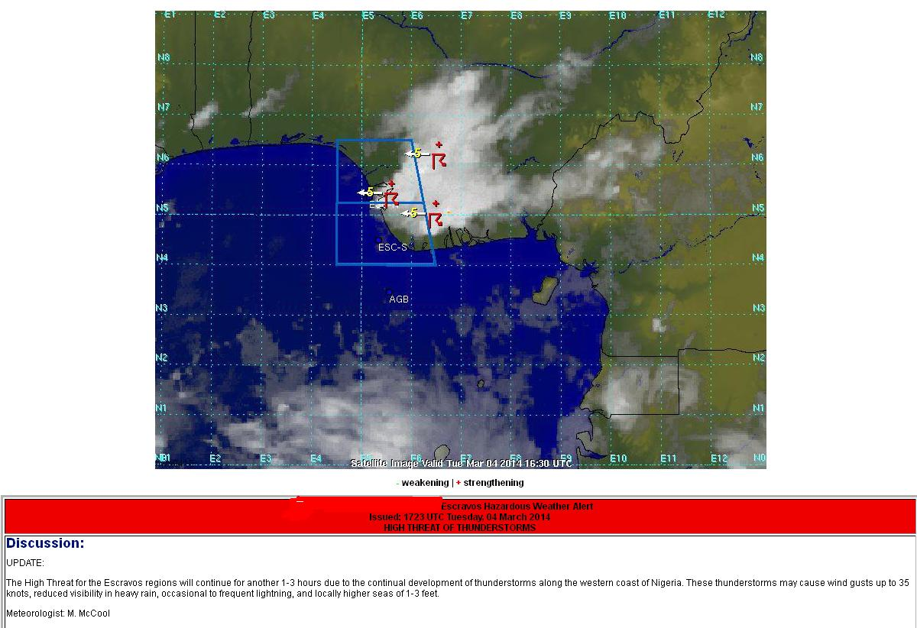
Marine Alert Example

Slide 39
MarineWatch Overview
Wind and wave forecasting
Route Forecasting
Severe Weather Alerting
Opportunities to work offshore on drill ships

Slide 40
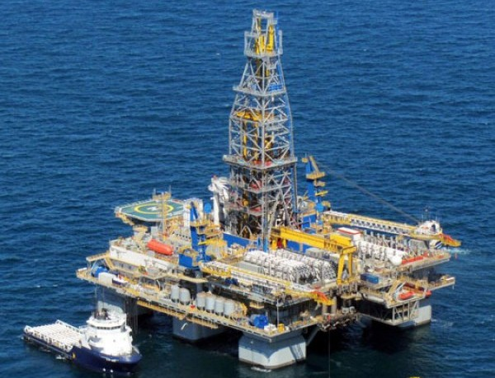
Meteorologists are sometimes deployed to offshore rigs

Slide 41
Interested in Career with ImpactWeather?
Send resumes to Jobs.Houston@stormgeo.com

