Slide 1
The Great Plains Storm Chase of May 2013 Featuring the EF-5 Moore, OK Tornado

Slide 2
Senior Trip!
Trip planned Nov. 2012
Duration
May 16 – May 24, 2013
Participants
Ohio State students & alum
Friends of the National Weather Service/Storm Prediction Center
Nighttime Storm in Norman, OK (May 21st)
Jared Allen, National Weather Service
LET’S GO CHASE SOME STORMS!!!

Slide 3
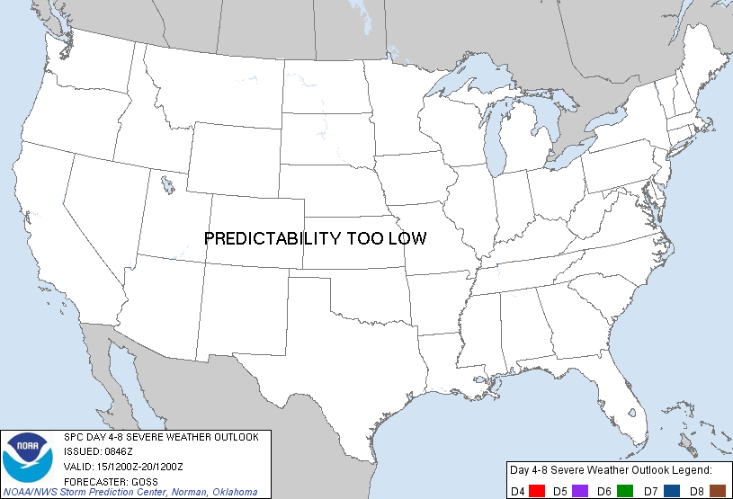

Slide 4
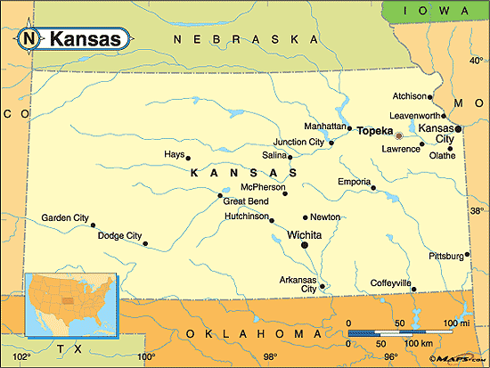
Chase Day 1: May 18th, 2013

Slide 5
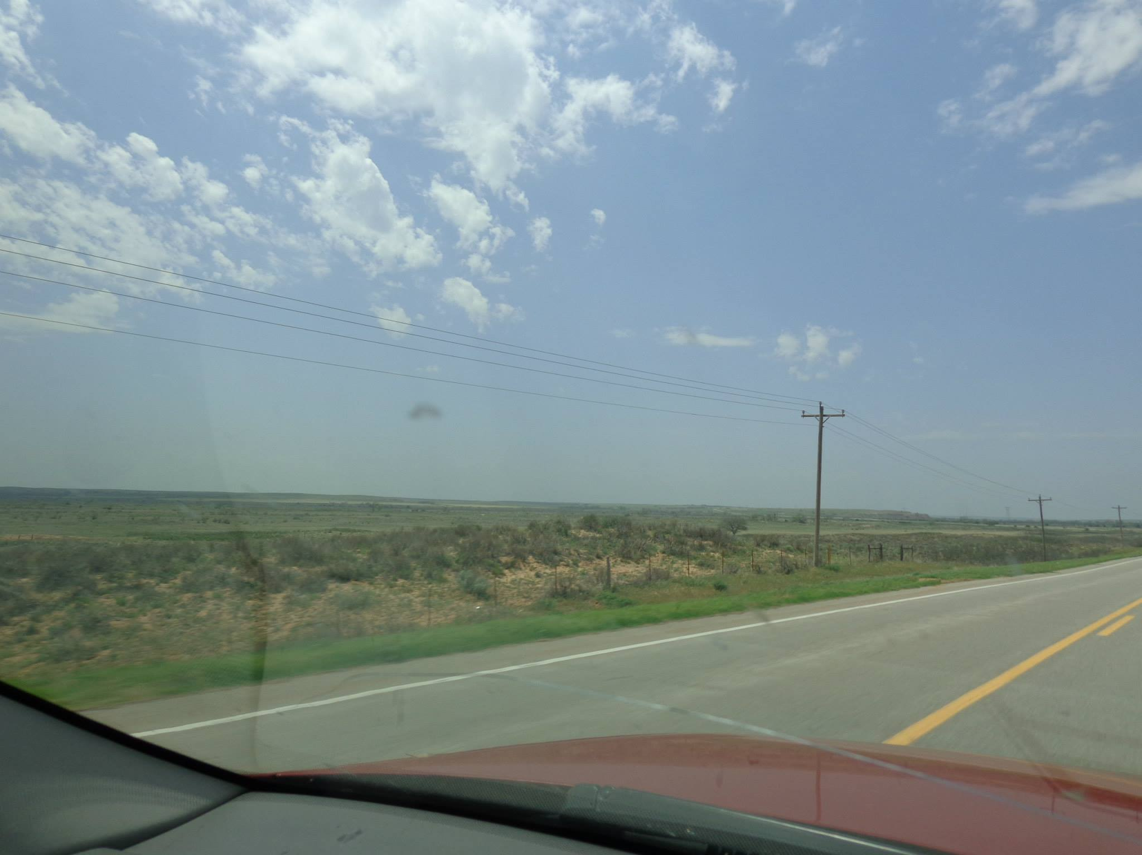
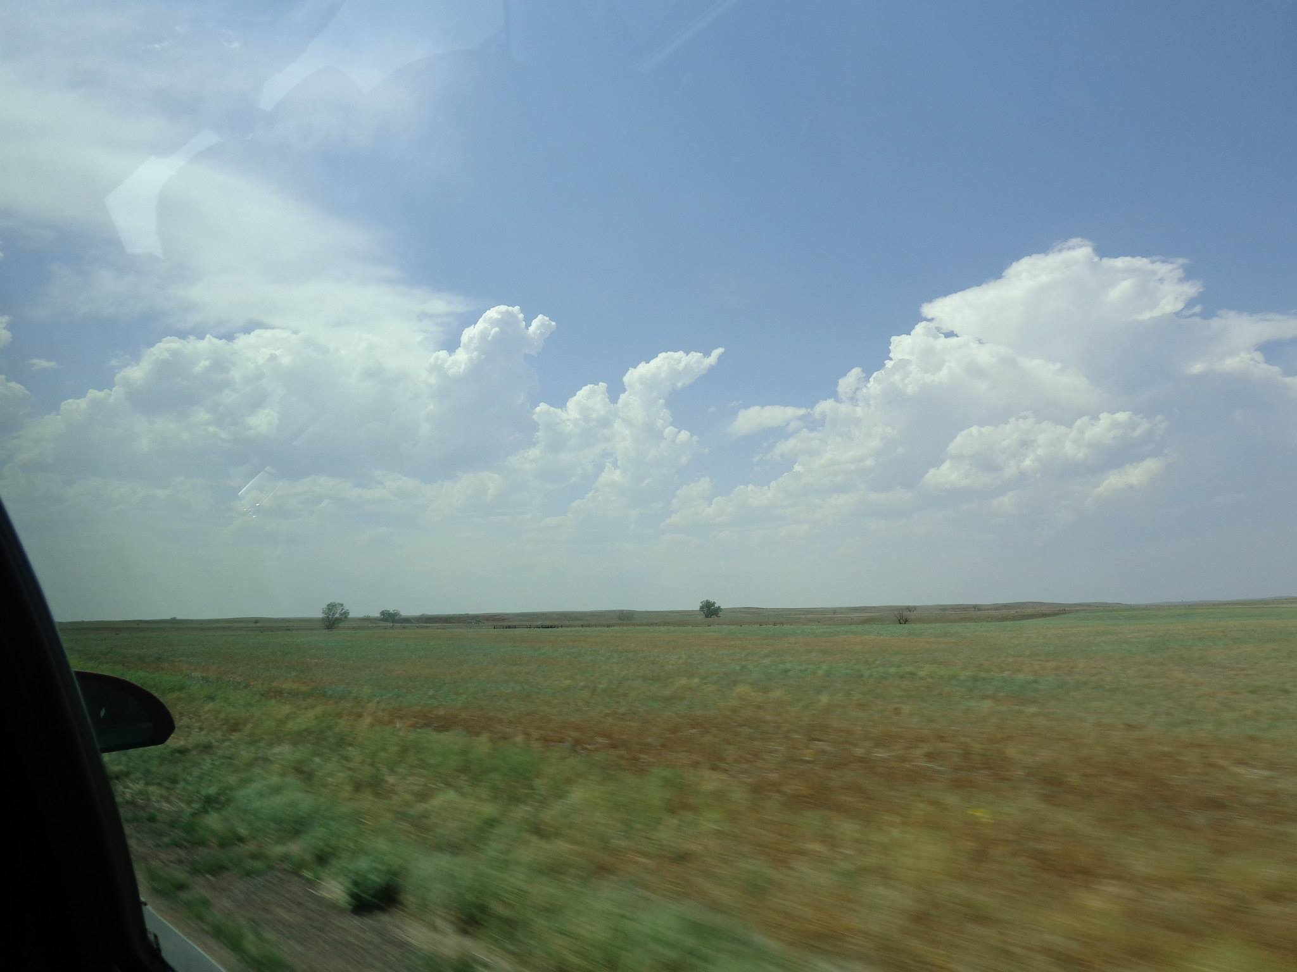
CLEAR SKIES – PERFECT
Strong surface heating
Storms firing up ahead of dryline

Slide 6
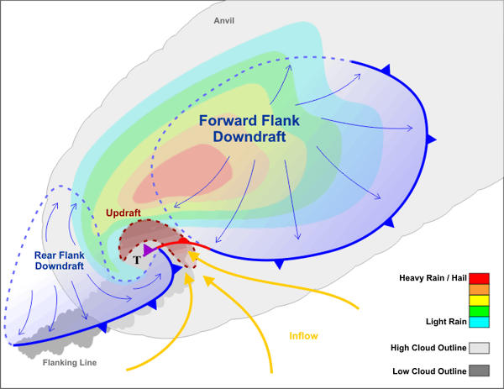
Supercell Structure and Ideal Vantage Point
Typical Storm Motion
Vantage Point

Slide 7
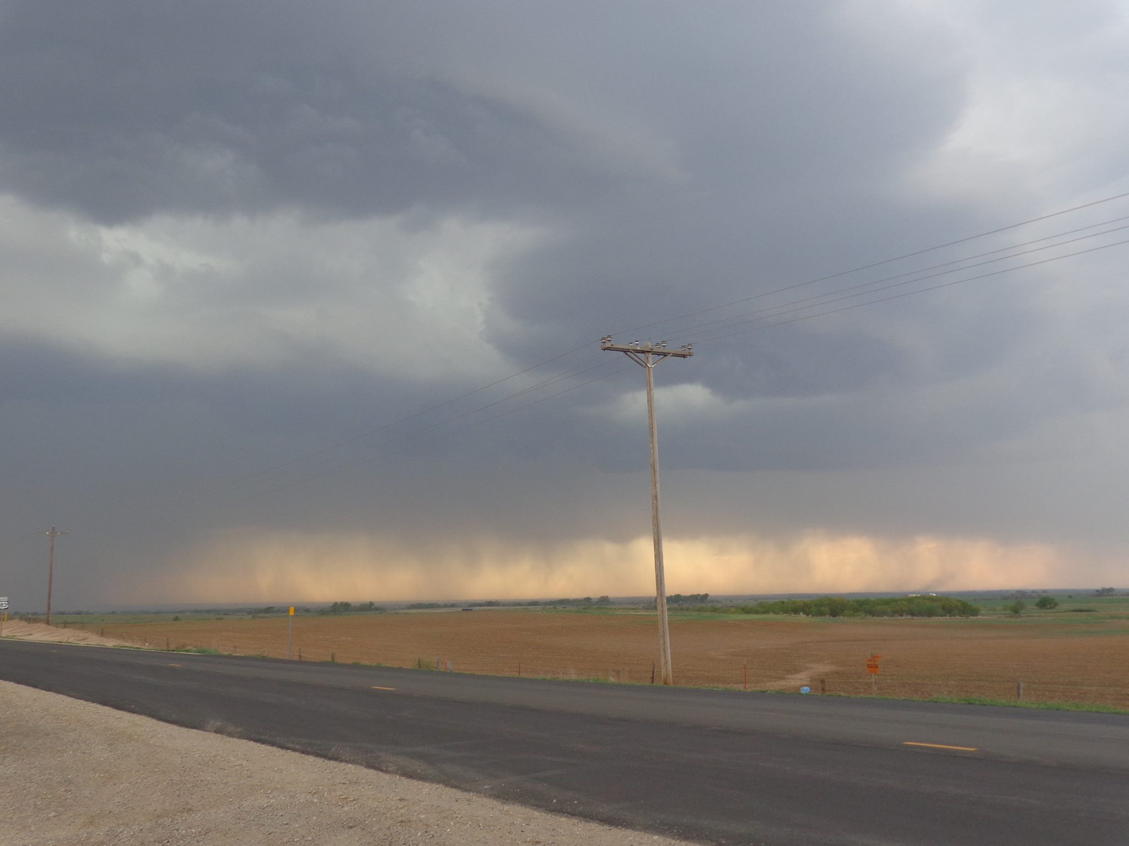
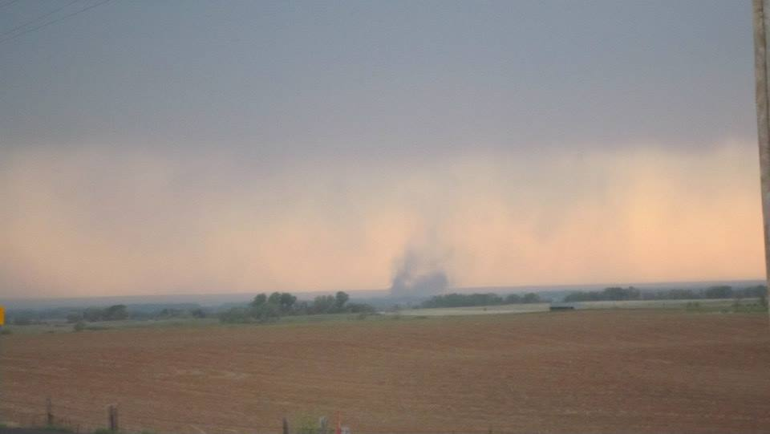
Gustnado

Slide 9
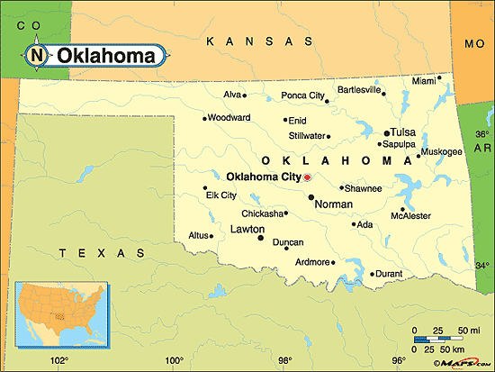
Chase Day 2: May 19th, 2013

Slide 10
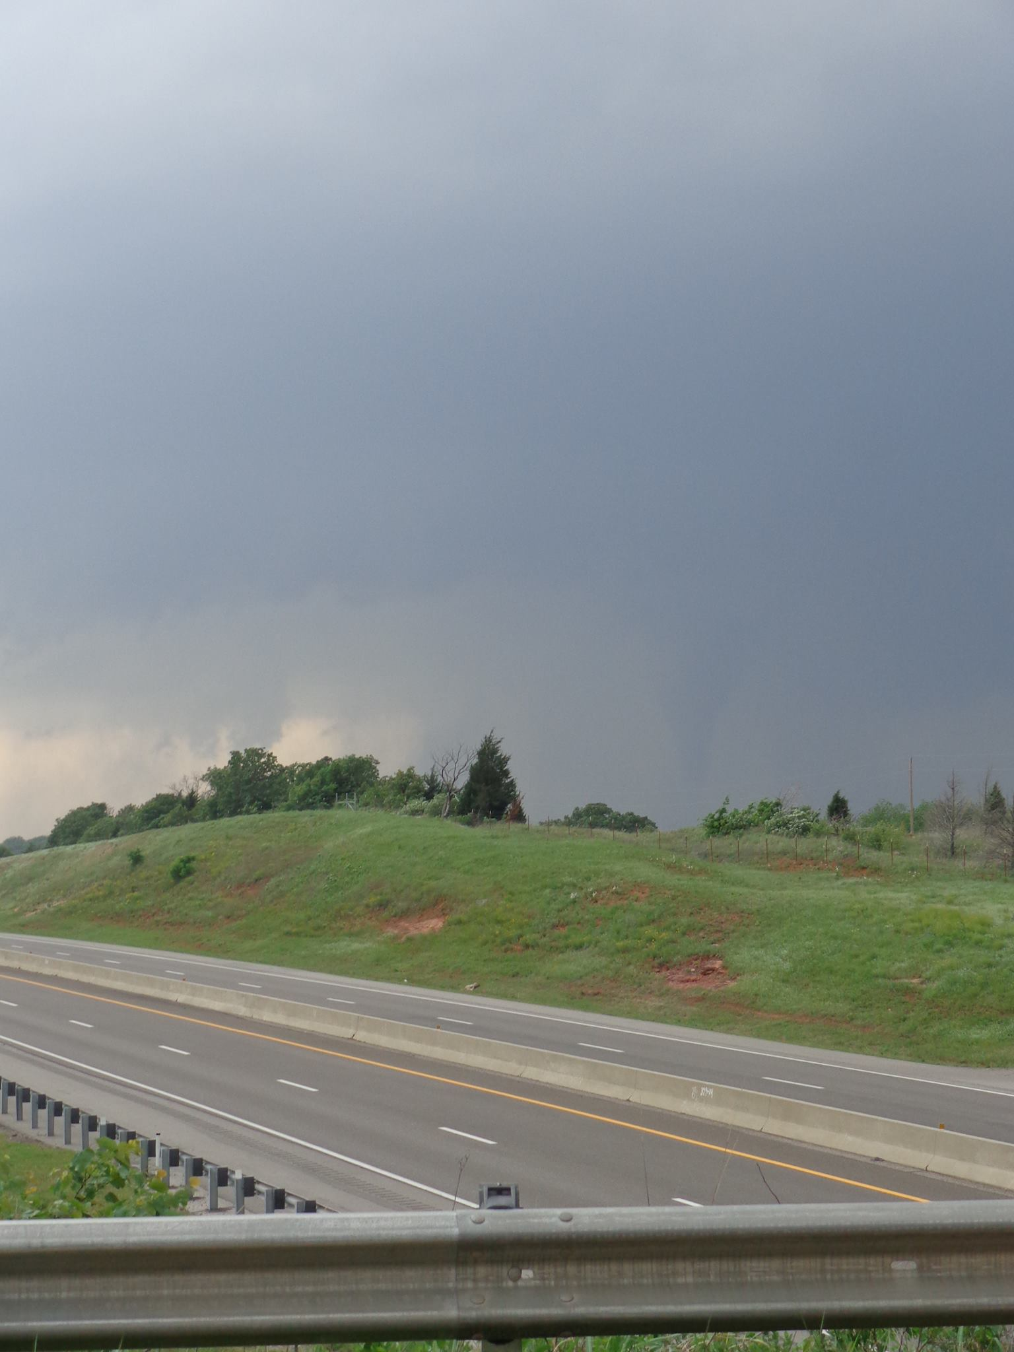
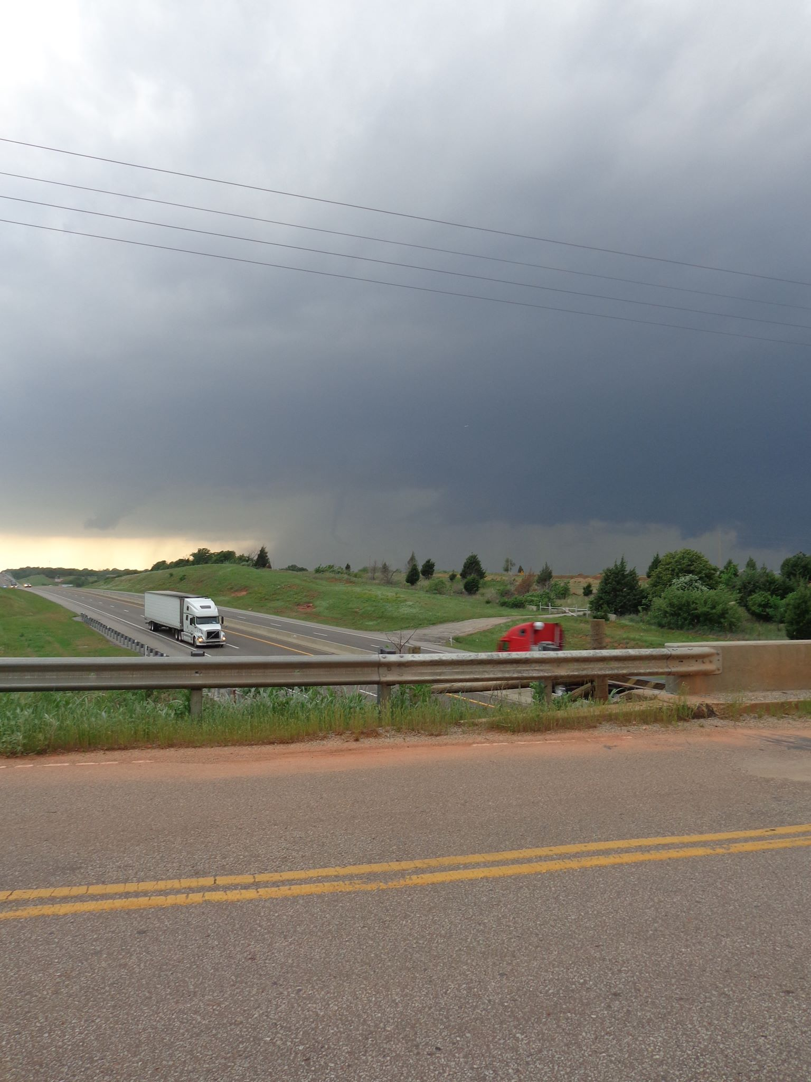
WHERE
IS
THE
TORNADO?
“Rope out” stage
Tornado is dissipating
Notes:
Saw my first tornado!
Rain wrapped :/
Try again tomorrow…
Need SLIDE ANIMATIONS!!!

Slide 11
Modeling Tornado Dynamics
“Genesis and Maintenance of a long-track EF-5 Tornado”
Models an EF-5 tornado that occurred outside of Oklahoma City on May 24, 2011
Modelers
Leigh Orf, Central Michigan University
Roberth Wilhelmson, NCSA/UIUC
Louis Wicker, NSSL
Bruce Lee, WindLogics
Catherine Finley, WindLogics
Cloud Model 1 (CM1)
3-D numerical simulation
Deep precipitating convection
http://www.srh.noaa.gov/oun/?n=events-20110524

Slide 12
Touchdown Simulation

Slide 13
A Look Inside

Slide 14
Streamline Analysis

Slide 15
Streamline Analysis

Slide 16
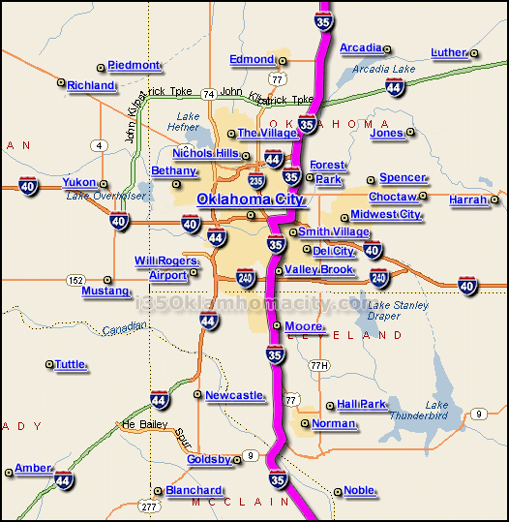
Chase Day 3: May 20th, 2013 The Moore, Oklahoma Tornado

Slide 17
May 20th, 2013 (15Z)

Slide 18
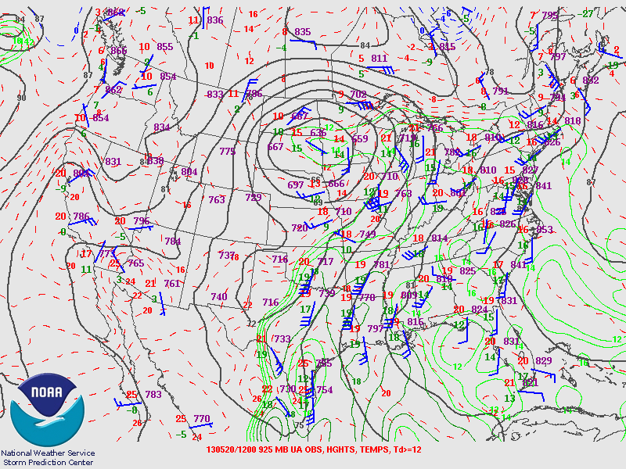

Slide 19
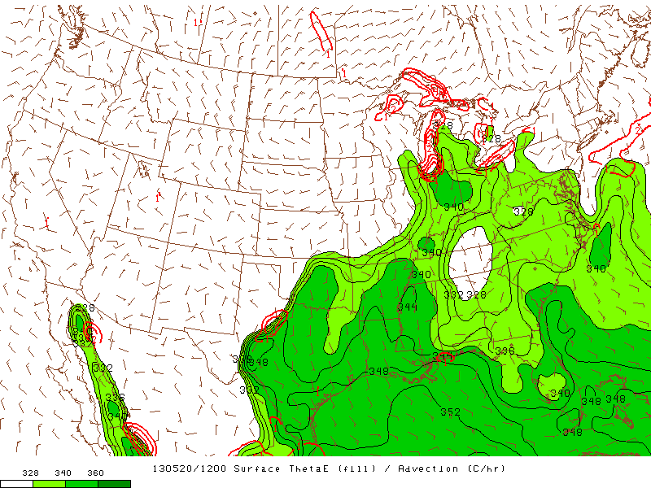

Slide 20
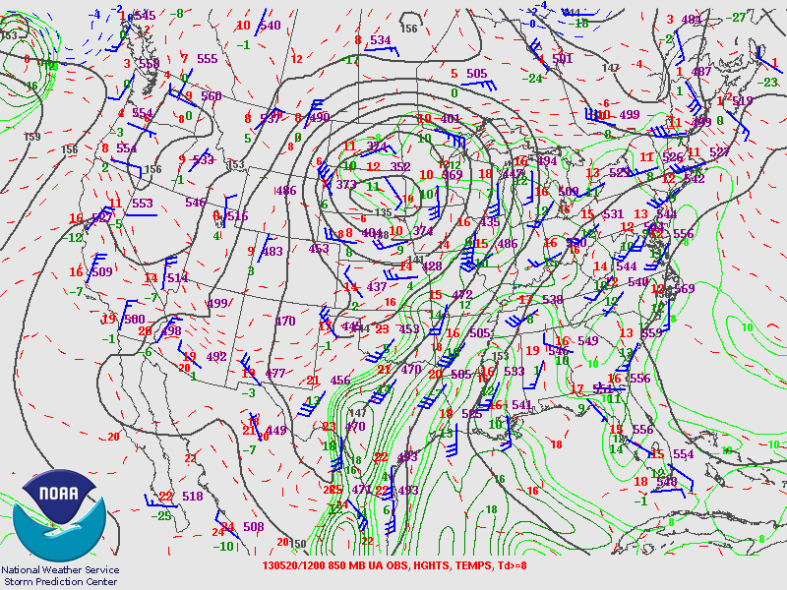

Slide 21
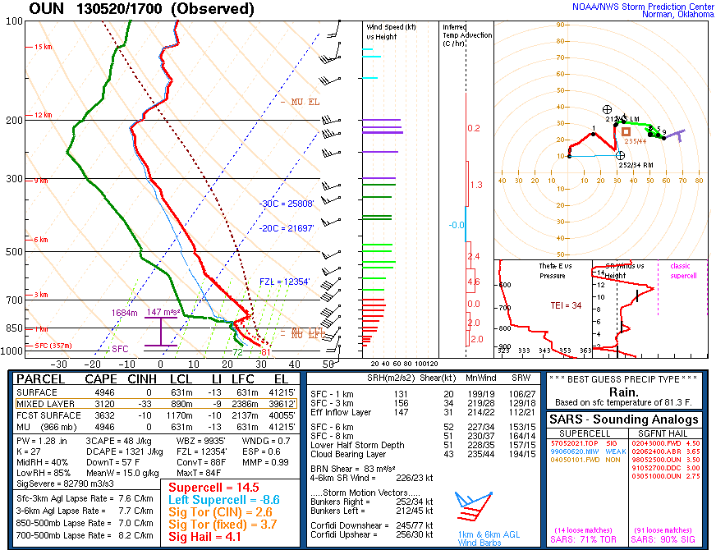

Slide 23
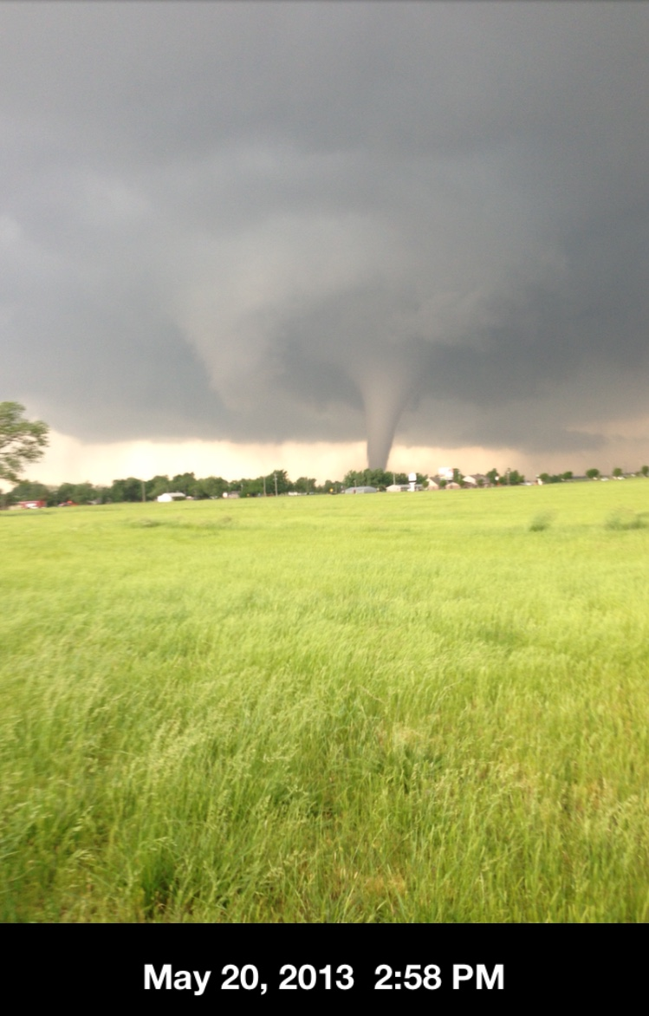
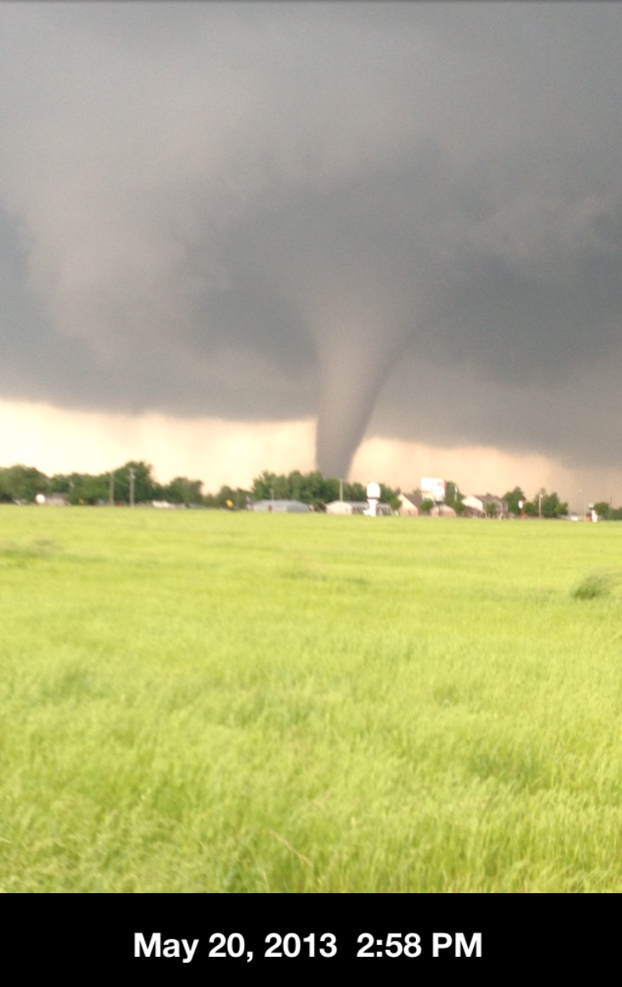
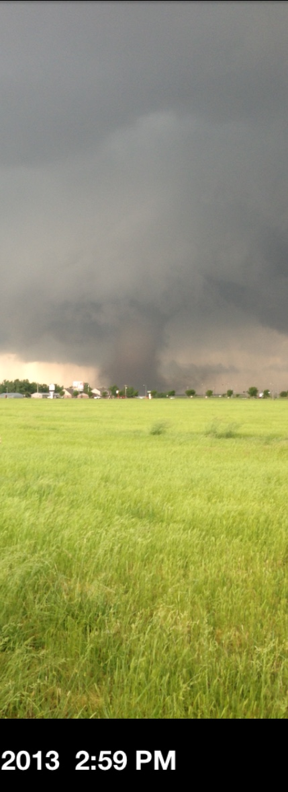
Rapid Intensification

Slide 24
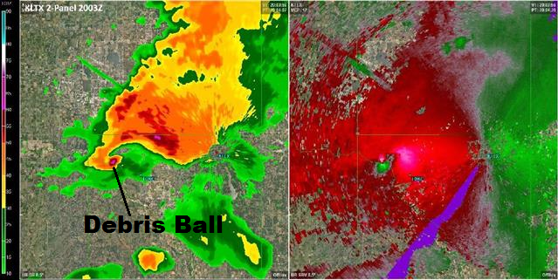
Base Reflectivity
Storm Relative Motion
Radar Site

Slide 27
Damage path 14.5 miles; max width > 1 mile
EF0 and EF1 damage in northern Newcastle at 2:56 PM CDT
EF2, EF3 and EF4 damage observed 4 minutes later.
EF4 damage continues through Briarwood and Plaza Towers elementary schools.
Few locations experience EF5 damage.
24 fatalities
EF Rating | 3 Second Wind Gust (mph)
0 | 65 - 85
1 | 86 - 110
2 | 111 - 135
3 | 136 - 165
4 | 166 - 200
5 | >200
3:36 PM
3:29 PM
3:16 PM
3:00 PM
2:56 PM

Slide 28
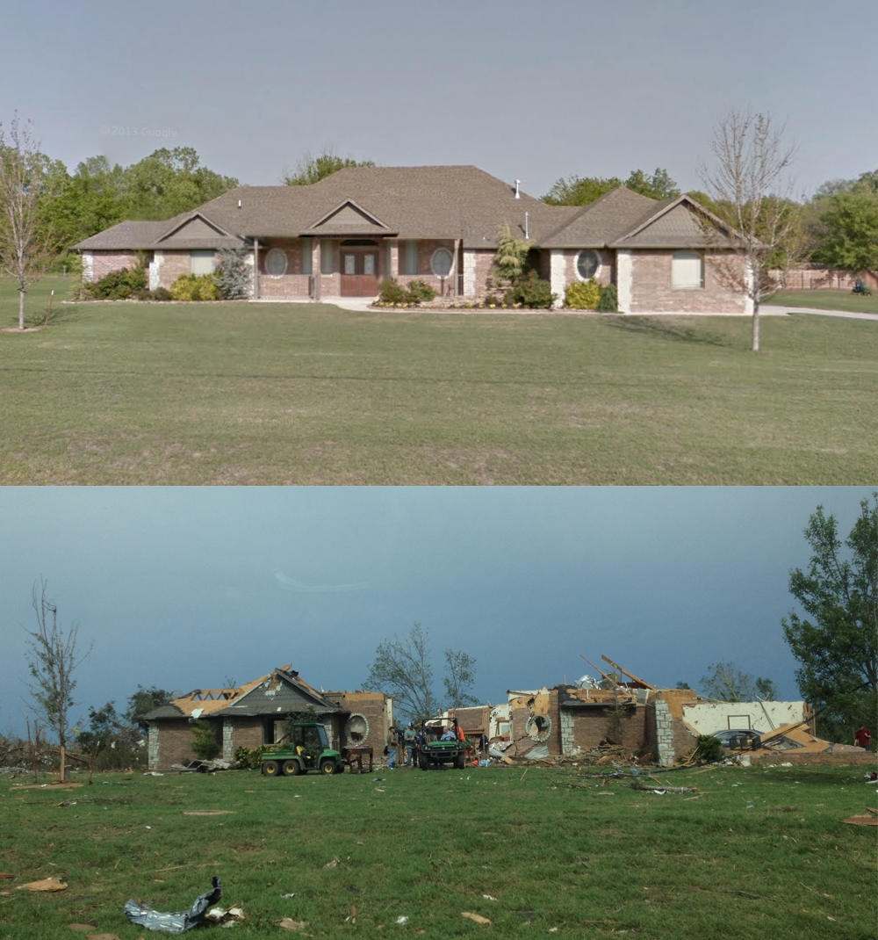
Chris Birchfield National Weather Service

Slide 29
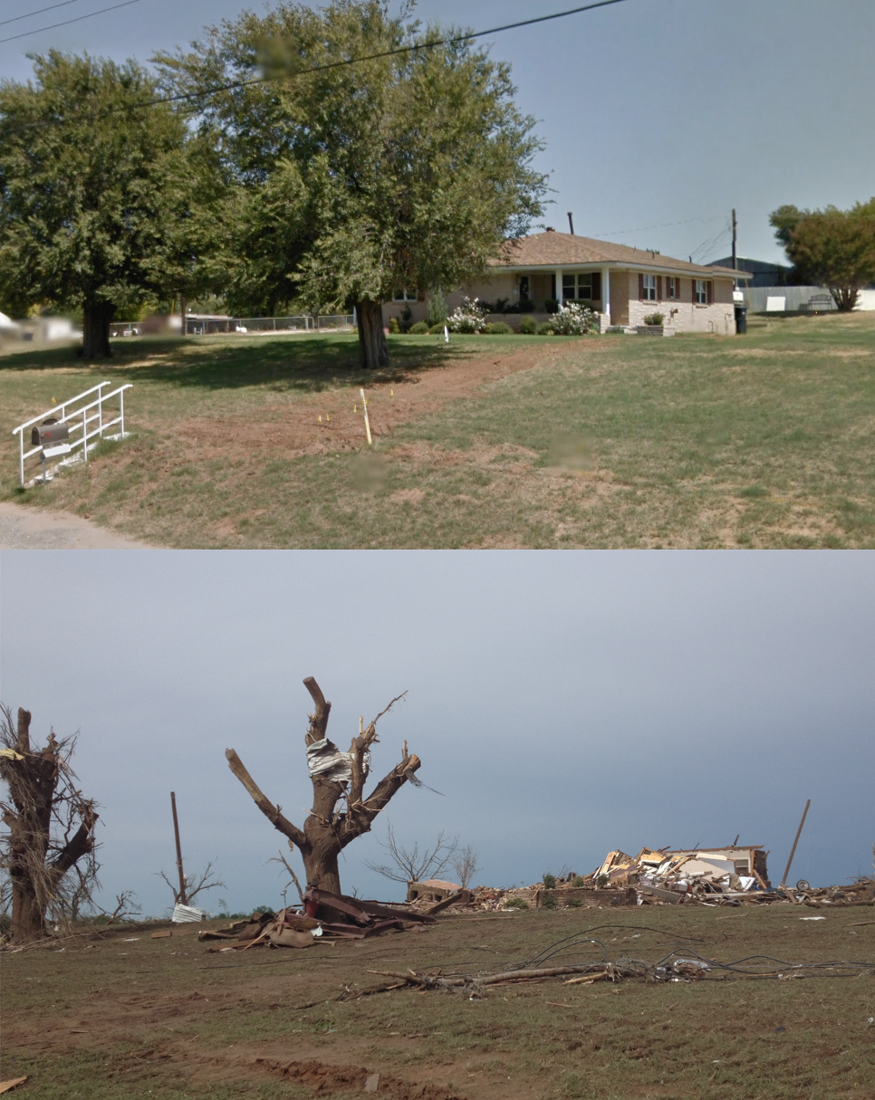
Chris Birchfield National Weather Service

Slide 30
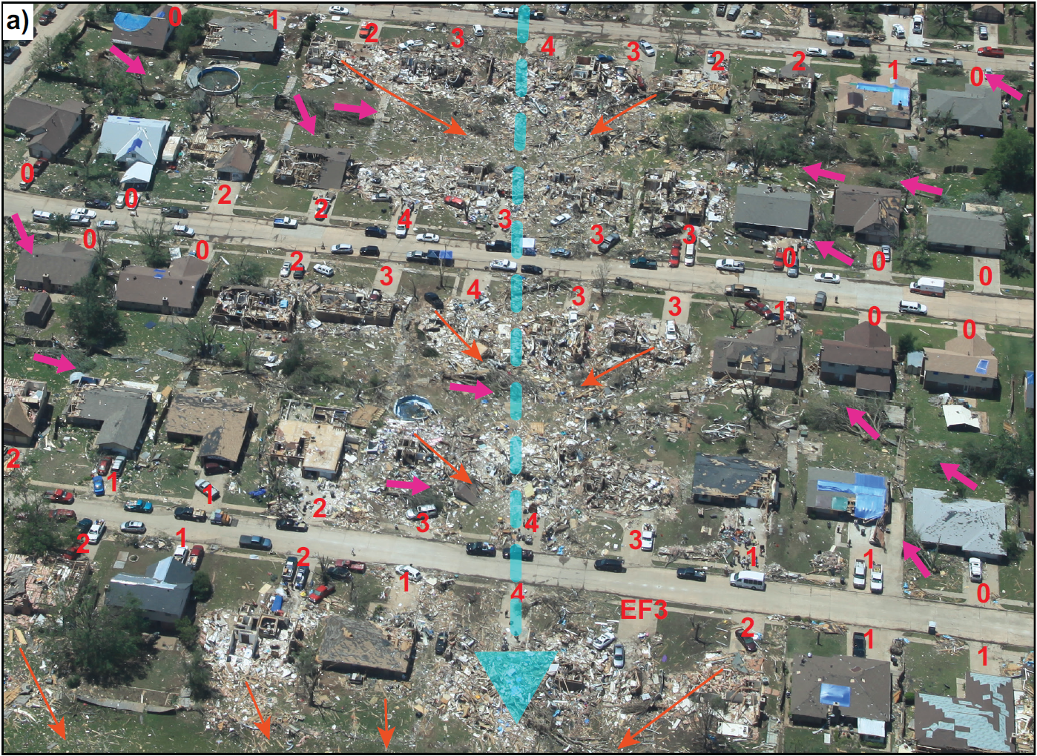

Slide 31
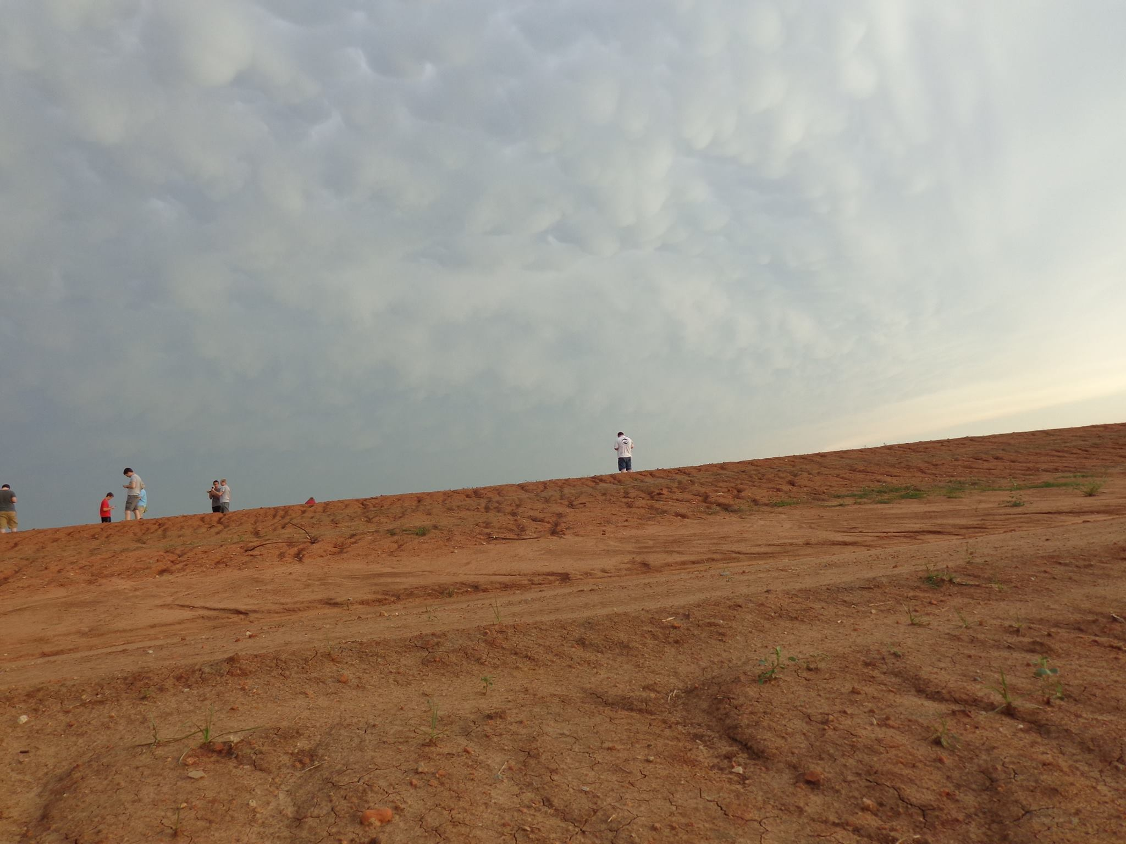
Reflections

Slide 32
References
Nolan T. Atkins, Kelly M. Butler, Kayla R. Flynn, and Roger M. Wakimoto, 2014: An Integrated Damage, Visual, and Radar Analysis of the 2013 Moore, Oklahoma, EF5 Tornado. Bull. Amer. Meteor. Soc., 95, 1549–1561.
Storm Prediction Center Product & Report Archives: http://www.spc.noaa.gov/archive/
Tornado Simulations: Leigh Orf, Central Michigan University, Mount Pleasant, MI; and R. B. Wilhelmson, L. J. Wicker, B. D. Lee, and C. A. Finley. “Genesis and maintenance of a long-track EF5 tornado embedded within a simulated supercell”.
Special thanks to Brian Shell, Chris Birchfield, and Jared Allen for some of the pictures!
Other images and radar animation: www.atmos.albany.edu, https://www.youtube.com/watch?v=ronIr-S3FJ0

