Slide 1
October 1994 Southeast Texas Flood…A Look Back
David C. Schwertz, CFM
Senior Service Hydrologist
National Weather Service Houston/Galveston

Slide 2
Outline
Southeast Texas Floods
Overview
Meteorological Setup
Event Timeline
Impacts
Trinity River Basin
San Jacinto River Basin
Lavaca-Navidad River Basin
Photo Gallery
Summary
A Final Surprise!?

Slide 3
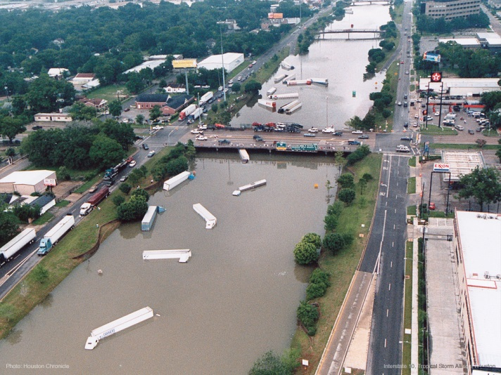
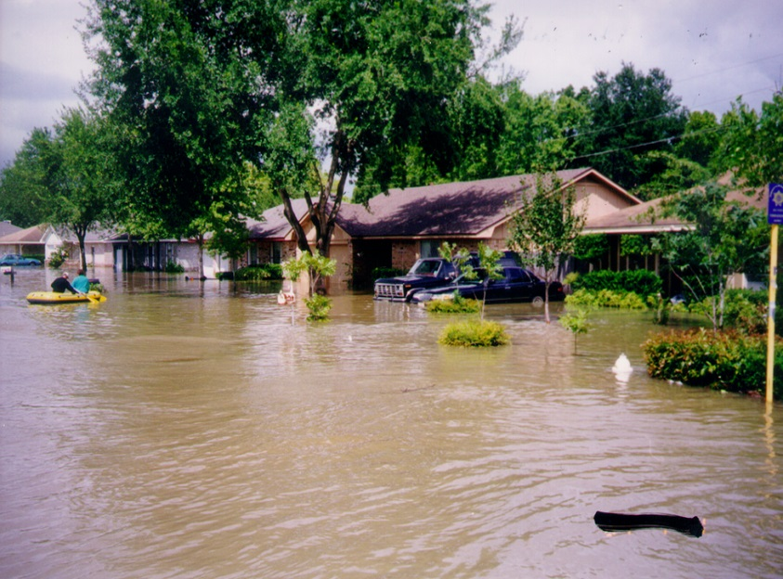
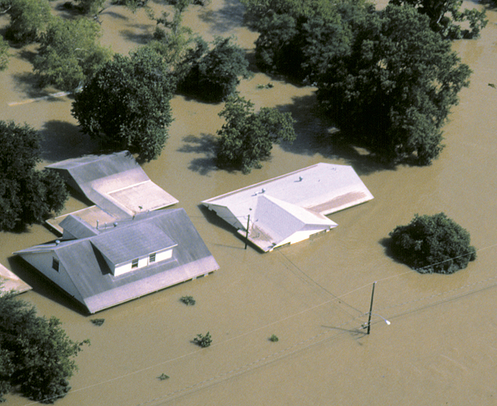
Floods in Southeast Texas
Interstate 10 Houston
March 1993.
Southeast Texas is no stranger to excessive flood events.
Woodland Trails West Subdivision September 1998.
Greens Bayou
June 2001.

Slide 4
Southeast Texas Floods October 16-19 1994
Prolonged heavy rain event over southeast Texas Sunday October 16 – early Wednesday October 19 1994.
In excess of 10 inches of rain covered an area larger than South Carolina.
In excess of 20 inches of rain observed over portions of 12 counties.
Maximum rain 30.5 inches at Liberty, Texas 35 miles northwest of Houston.
Peripheral rain gage data combined with radar estimated rainfall strongly suggest the headwaters of Spring Creek in southwest Montgomery County received in excess of 30 inches of rain.
Areas north through northwest of Houston received the bulk of their rainfall Sunday night and Monday morning. Areas south and southeast of this line received their rainfall Monday into Tuesday.
Heavy rains over the extreme lower Colorado and Lavaca-Navidad River Basins occurred late Tuesday into Wednesday.

Slide 5
Meteorological Setup
Unusually intense, closed low pressure system settled over the Rockies.
An equally unusual and intense dome of high pressure established itself over the eastern Gulf of Mexico.
No significant change in orientation of this ridge-trough pattern was expected to occur for several days.
Southeast Texas was located on the western side of the large scale ridge.
Resulting flow into eastern Texas was a deep southerly current with roots in the tropical Caribbean.

Slide 6
Many Characteristics Associated with Disastrous Flood Events Present
Precipitable water 150% normal
Strong moist and unstable low level inflow
Tropical moisture plume
Strong upper level difluence
Mesoscale focusing mechanism
Weak warm front
Mesoscale outflow boundary

Slide 7
Event Timeline
Sunday October 16 AM
Scattered showers and thunderstorms with little organization begin to develop early extending from south of San Antonio northeastward into northeast Texas.
Some organization evident north and east of Lake Livingston.
Convection increased in both intensity and areal coverage during the afternoon hours.
Area extended from east of San Antonio northeast through Texarkana
Cells repeatedly tracked northeast over the same area (cell training).
Most areas received less than 1 inch but two areas, along Kickapoo Creek north of Lake Livingston and areas south and west of College Station received 3 to 4 inches.
Illustration of cell training.

Slide 8
Event Timeline
Sunday October 16 PM
Changes in Mesoscale organization during the evening hours played a major role in focusing heavy rainfall that first night.
Convection became organized into two distinct multi-cellular clusters, one northwest of Huntsville to southwest of Lufkin and the other from near Brenham to northeast of College Station
Cells forming south of these boundaries were moving north northeast near 30 mph and merging with the clusters
Illustration of mesoscale cluster development

Slide 9
Event Timeline
Monday October 17 AM
During the overnight hours these two clusters merged and continued developing slowly south and east.
Well defined outflow boundaries oriented east to west along the southern flanks of the clusters.
Radar indicated air flow south of the clusters was southerly at 35 to 50 knots.
By daylight the boundary extended from near Hempstead southeast across northern Harris County to near Baytown then east to near Beaumont.
Average movement of the line was 10 mph.
One area of heaviest rainfall was southwest Montgomery County with an estimated 15 to 20 inches.
Two hour evolution of mesocale outflow boundary 02-12 UTC 10/17/1994

Slide 10
Event Timeline
Heavy rain continued through Monday along and north of this boundary.
New convection developed in the warm air to the south then moved north across the boundary.
This boundary continued to provide a focus for heavy rain into Wednesday morning.
Tuesday October 18
New clusters formed late Monday into Tuesday across northern Brazoria, eastern Harris, and Liberty Counties.
Wednesday October 19
New clusters formed late Tuesday into Wednesday from Victoria northeast to Wharton.
Each time these new clusters enhanced the heavy rainfall over their respective areas with heaviest rainfall throughout the event associated with the formation of these mesoscale clusters.

Slide 11
October 15-19, 1994

Slide 12
Storm Total Rainfall
Radar
Rain Gauge
Heavy rainfall occurred over the entire 38 county area affected by the storm, an area about the size of the State of Maine.

Slide 13
Storm Total Rainfall
Heavy rainfall occurred over the entire 38 county area affected by the storm, an area about the size of the State of Maine.

Slide 14
Area-Wide Rainfall
Rainfall was heavy over the entire 38-county area affected by the storm.
The area affected measures roughly 300 miles x 170 miles…about the size of the State of Maine.
9”
23”
13”
21”
29”
17”
12”
18”

Slide 15
Trinity River Impacts
Kickapoo Creek northeast of Lake Livingston in Polk County peaked at 84,000 cfs (41.85 feet), more than 3 times the previous record!
Long King Creek, on the west side of the City of Livingston in Polk County peaked at 45,000 cfs (30.54 feet), almost twice the previous maximum.
Trinity River near Goodrich below Lake Livingston on the Polk/San Jacinto County line peaked at 124,000 cfs (48.93 feet).
Trinity River at Romayor in Liberty County peaked at 122,000 cfs (42.7 feet).
Trinity River at Liberty in Liberty County peaked at 135,000 cfs (31.00 feet).

Slide 16
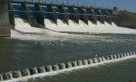
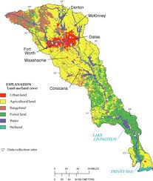
Lake Livingston
Lake Livingston discharge reached a maximum of 110,600 cfs . The maximum lake level was 134.38 feet, 3.38 feet above the normal pool elevation of 131.00 feet. All this despite the storm affecting only the lower portion of the watershed!
Watershed Area = 17,573 square miles

Slide 17
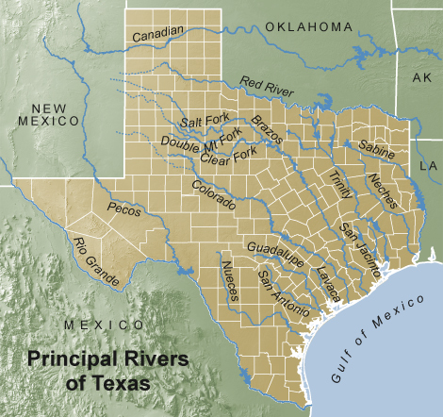
Geographic Setting
Smallest major river
basin that drains Texas.
Lies between larger Trinity and Brazos Rivers.
Trinity 17,573 mi²
San Jacinto 2897 mi²
Brazos 35,773 mi²
Does not extend into heart of Texas…only 140 km into state.
Ranges in elevation from 425 feet to sea level.

Slide 18
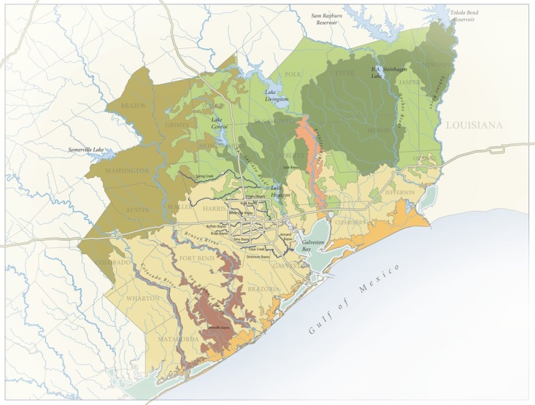
Topography and Climate
Above Lake Conroe on West Fork
Rolling hills ~300 to 400 feet altitude
Average slope .1% w/locally steeper areas
Below CFKT2 relief quite flat, average slope .06%
Climate ranges from
Humid northeast to moist sub-humid west
Precipitation ~40 inches northwest to ~48 inches southeast

Slide 19
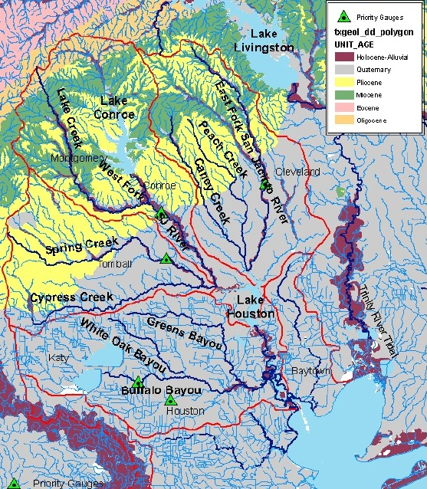
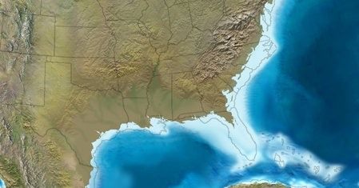
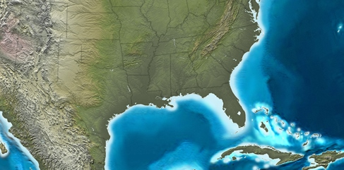
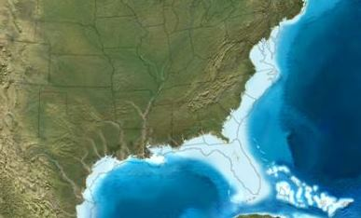
Geologic Setting
Drains
Miocene (23 – 5.3 Ma)
Pliocene (5.3 – 2.6 Ma)
Quaternary (2.6 Ma – Present) terrain

Slide 20
Geologic Setting
Uncharacteristically sandy basin by comparison
Predominately due to sand rich stratigraphic units
Sediment supply limited to a small area
Incised into gently seaward sloping coastal sediments
Sands
Silts
Minor gravels
Clay

Slide 21
Geologic Setting
Lower San Jacinto River in an entrenched valley
Comprised of entrenched valley fill
Floodplain deposits
Oxbow lakes
Back swamp deposits
Point bar accretionary deposits
Caused by several Pleistocene sea level rises and falls associated with glacial and interglacial cycles

Slide 22
Hydrologic Setting
Drains approximately 2973 mi²
North and east of Houston
Three major sections
East Fork basin
Drains ~ one third of basin
West Fork basin
Drains ~ two thirds of basin
Lower San Jacinto
Below Lake Houston

Slide 23
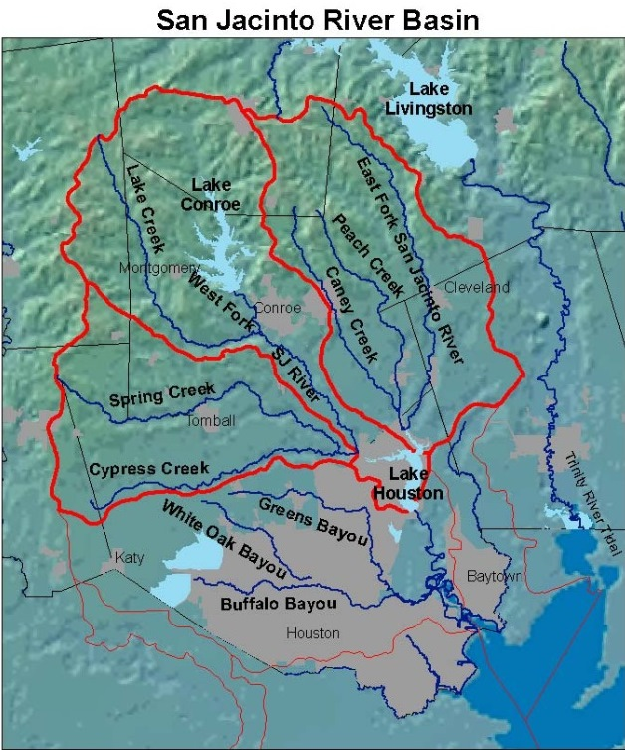
Hydrologic Setting
East Fork Basin
Drains one third of basin
~991 mi²
Two significant tributaries
Caney Creek
Peach Creek
West Fork Basin
Drains two thirds of basin
~1982 mi²
Three significant tributaries
Lake Creek
Spring Creek
Cypress Creek

Slide 24
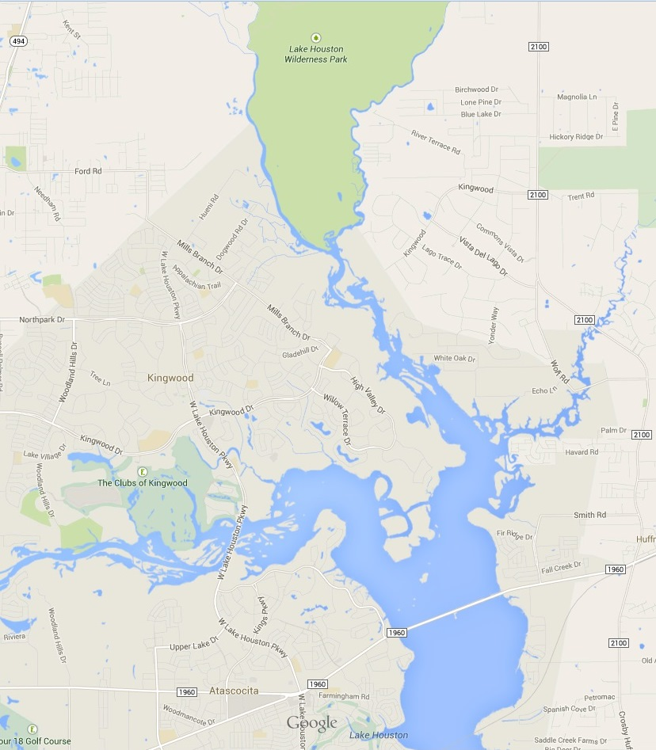
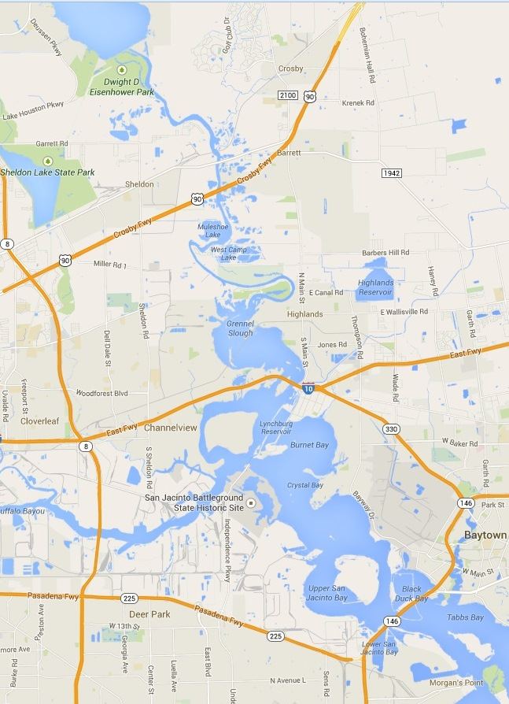
Hydrologic Setting
Lower San Jacinto Basin
Below Lake Houston
Two basins merge headwaters Lake Houston
Drains ~ 52 mi²
Flows out of Lake Houston ~ 18 miles to Houston Ship Channel
One minor tributary
Jackson Bayou
Subsidence in lower basin makes river nearly unrecognizable below Rio Villa Meander Loop
Predominately inundated with brackish water due to tidal flow from Galveston Bay

Slide 25
San Jacinto River Basin
San Jacinto River Basin
15 to 20 inches of rain over entire basin with isolated areas receiving 25+ inches.
Effective uniform depths within the basin 17.5 inches.
Peak discharge at Sheldon estimated 360,000 cfs ~1.5 times the 1% (100 year discharge).
Lake Houston at 133,900 acre-feet, filled and emptied 10 times during event.
Watershed Area = 2897 square miles

Slide 26
San Jacinto River Impacts
West Fork San Jacinto River near Conroe in Montgomery County crested at 115,000 cfs (32.30 feet) and broke a 54 year old record!
Spring Creek at Spring on the Harris/Montgomery County line peaked at 78,800 cfs (44.05 feet), almost twice the previous maximum.
Cypress Creek at Grant Road near Houston in Harris County peaked at 10,500 cfs (47.38 feet), three times the previous record.
East Fork San Jacinto River near New Caney on the Harris/Montgomery County line peaked at 74,100 cfs (33.00 feet), almost twice the previous record.

Slide 27
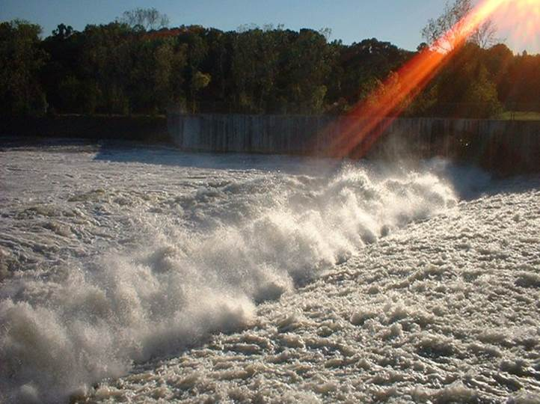
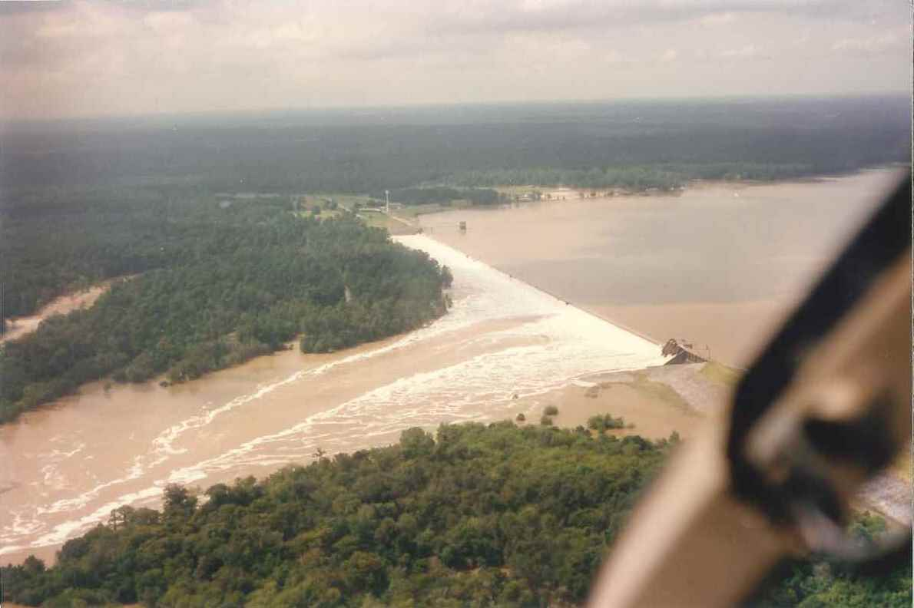
Lake Conroe/Lake Houston
Lake Conroe reached a maximum level of 205.88 feet (4.88 feet above the normal conservation pool of 201.00 ft). A peak discharge of 56,000 cfs was recorded at S.H. 105 a just below the dam.
Lake Houston discharge reached a maximum value of 359,000 cfs with a corresponding lake elevation of 52.8 feet, 8.3 feet above the crest elevation of the 3,160-foot long overflow spillway!

Slide 28
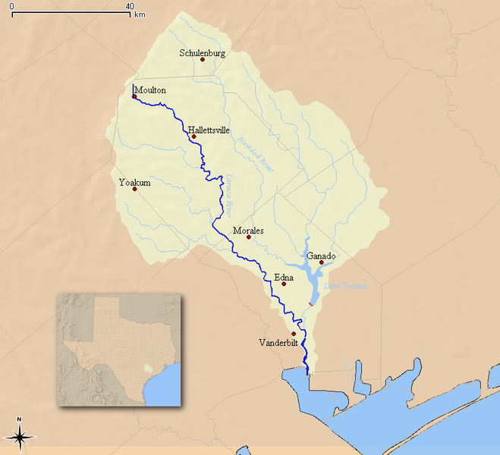
Lavaca-Navidad River Impacts
West Mustang Creek near Ganado in Jackson County peaked at 30,000 cfs (28.39 feet), more than twice the previous record.
Sandy Creek near Cordele in Jackson County peaked at 23,000 cfs (28.45 feet), almost twice the previous record.
Lavaca River near Edna in Jackson County peaked at 135,000 cfs (35.45 feet).
Image: USGS
Watershed Area = 2187 square miles

Slide 29
Storm Total Rainfall
Rainfall
Streamflow

Slide 30
Record Streamflows
Stream flows in equal to or in excess of 1% flood were recorded at 19 USGS gages within the affected area with new historical maxima recorded at 25 of 43 stations!

Slide 31
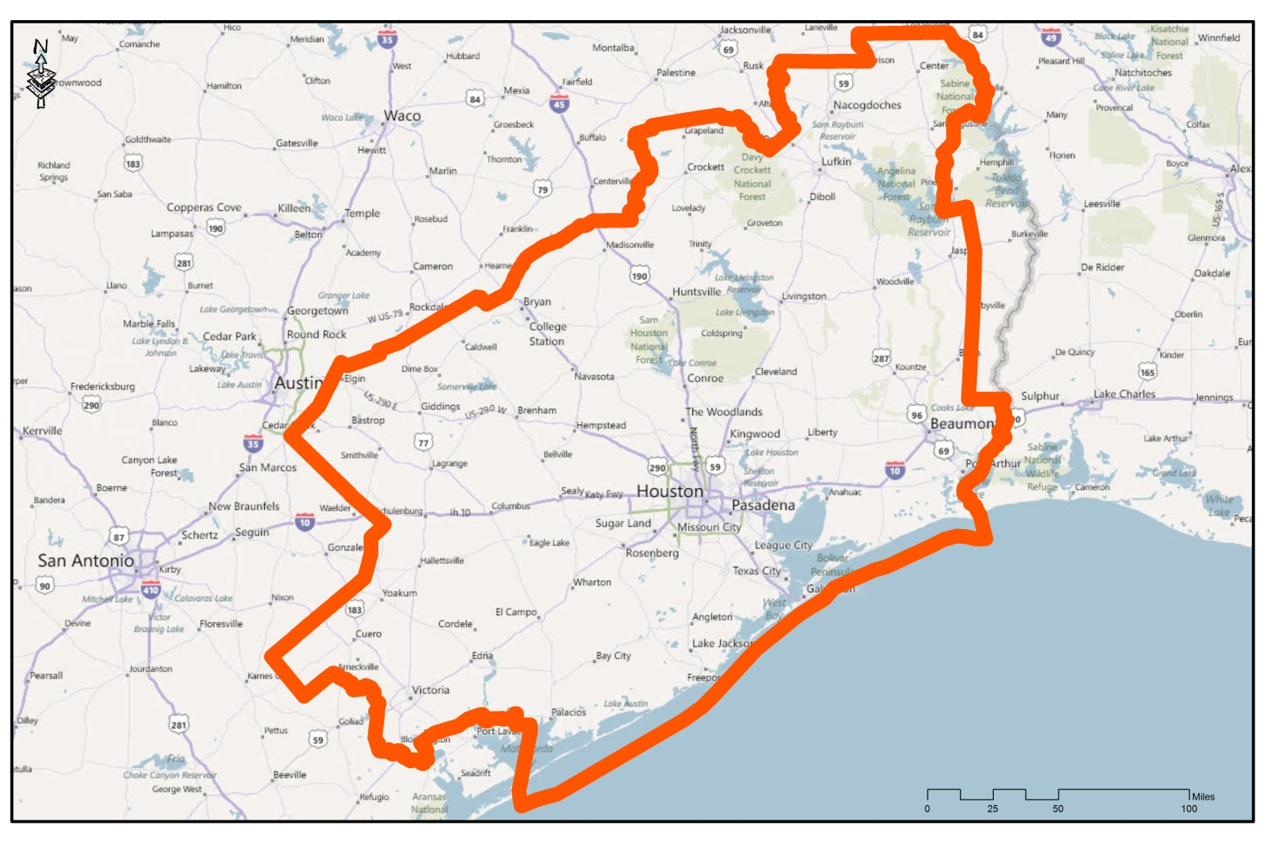
Record Stream Flows
Stream flows in excess of 1% flood were recorded at 19 USGS gages within the affected area, with new historical maxima recorded at 25 of 43 stations.

Slide 32
Little Cypress Creek at Cypress-Rosehill Road

Slide 33
Cypress Creek at Huffmeister Road

Slide 34
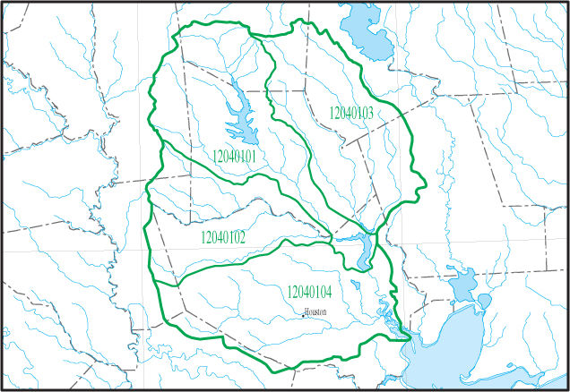
Cypress Creek Overflow
Direction of Overflow
Cypress Creek Channel
Cypress Creek overflowed its banks, sending thousands of acre-feet of storm water cross-country to the Addicks and Barker Reservoir watersheds, inundating thousands of acres of land.

Slide 35
Cypress Creek at Aldine-Westfield Road

Slide 36
Displaced Power Lines San Jacinto River

Slide 37
Forest Cove Subdivision

Slide 38
Forest Cove Subdivision

Slide 39
Toys R Us at U.S. Hwy 59 in Humble

Slide 40
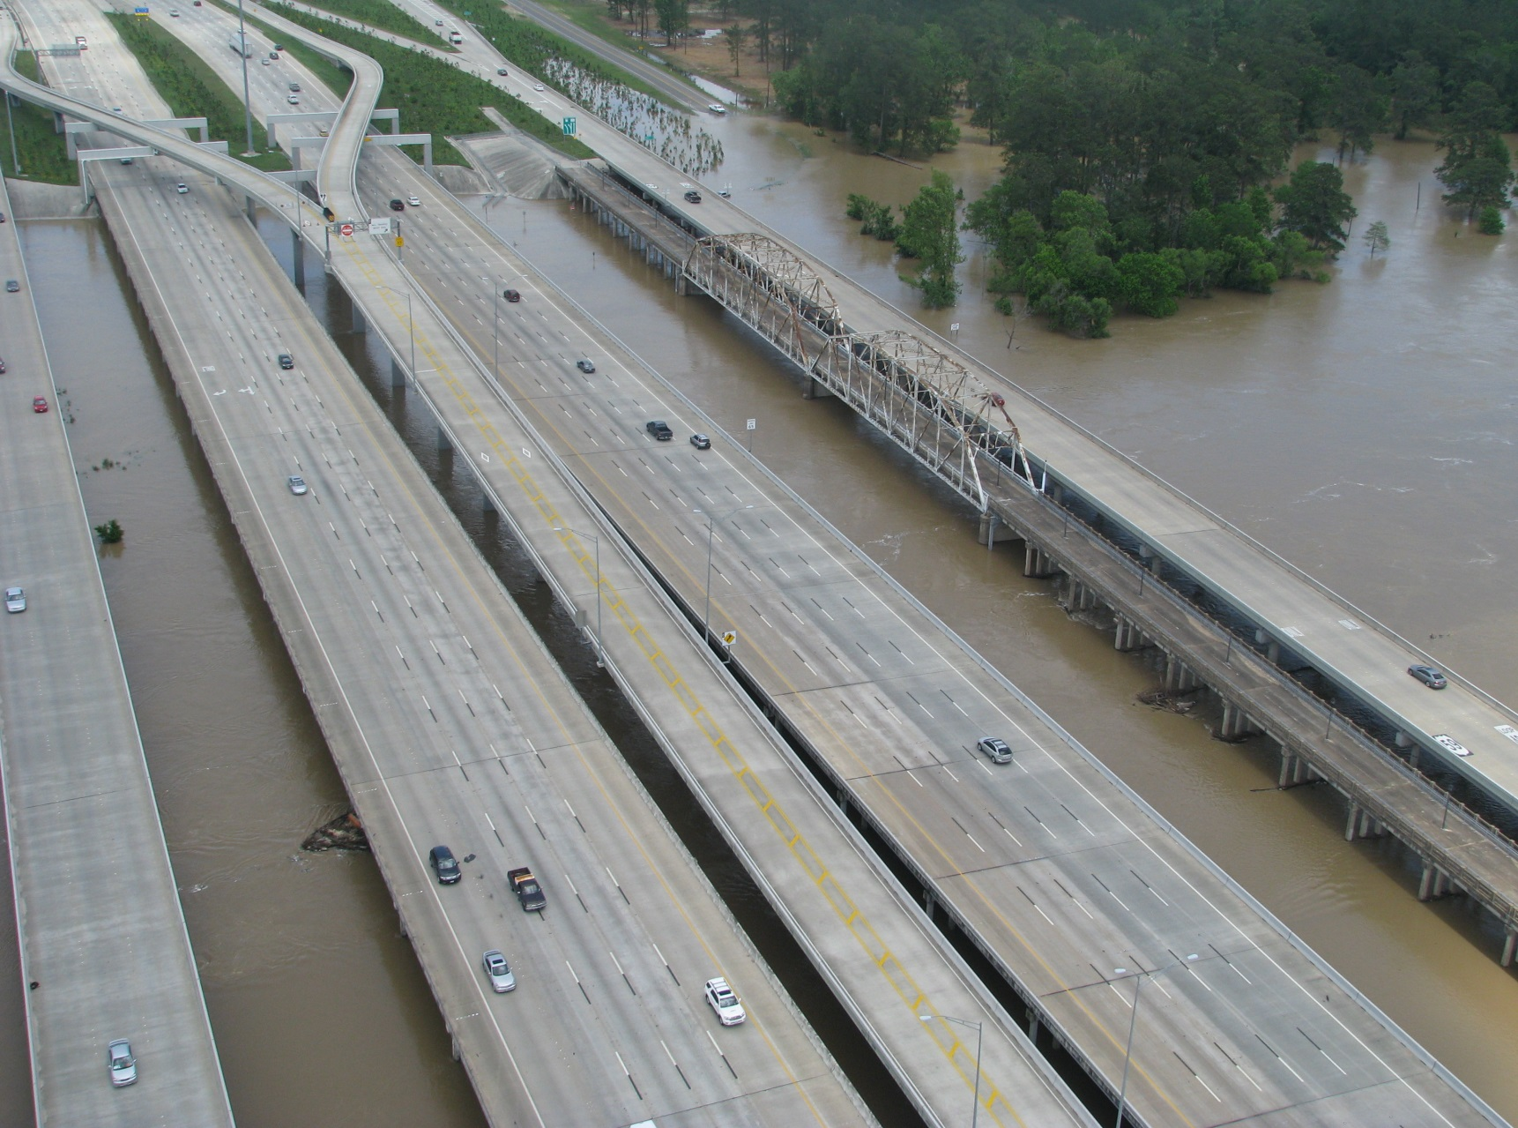
U.S. Hwy 59 at San Jacinto River

Slide 41
U.S. Hwy 59 Northbound Feeder Road

Slide 42
U.S. Hwy 59 Southbound Turnaround

Slide 43
Banana Bend/Rio Villa Area below Lake Houston

Slide 44
San Jacinto River at I-10

Slide 45
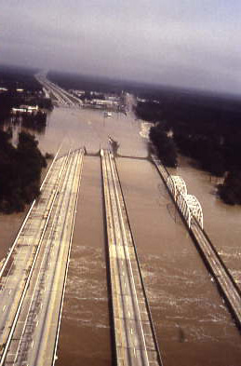
Southeast Texas Floods October 16-19 1994
Summary of Event
Widespread flooding from the Lavaca-Navidad River in south central Texas east to the Sabine River.
More than 19 new floods of record set on area rivers and streams as well as several record pool elevations on area reservoirs.
38 southeast Texas counties declared total or partial disaster areas.
87 water systems contaminated or otherwise affected.
Numerous roads, bridges, and culverts washed out, damaged or destroyed.
Interstate 10 and U.S Highway 59 flooded.
Over 20,000 homes, several schools, and numerous businesses flood damaged.
Over 10,000 people evacuated from flooded areas.
22 confirmed deaths.
US59 San Jacinto River - Oct. 1994.

Slide 46
As if all that wasn’t bad enough…

Slide 47
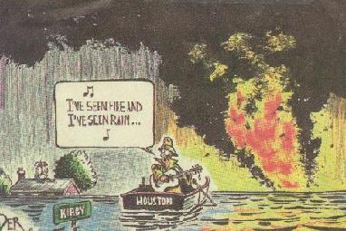
Southeast Texas Floods October 16-19 1994
Kerwin Plwvka, Houston Chronicle
The San Jacinto River caught fire!!

Slide 48
Acknowledgements
Bill Read, Former MIC NWS Houston/Galveston
Jeff Lindner, Flood Watch Manager HCFCD
Fred Liscomb & Jeff East, USGS Water Science Center Houston
Andy Yung, Walter P. Moore and Associates
Duane Barrett, HDR Engineering
All photos courtesy TRA, SJRA, HCFCD, USGS, NWS

Slide 49
Questions?
Contact
Dave Schwertz
NWS Houston/Galveston
1353 FM 646 W, Suite 202
Dickinson, Texas 77539
dave.schwertz@noaa.gov
Visit our Web Page www.srh.noaa.gov/hgx

